Slide 1


JOINT TUTORIAL
UCIe Open Chiplet Ecosystem Standard
&
UALink Scale-Up AI Fabric Chiplet Standard
Hot Interconnects
August 21, 2026

Slide 2






Benefits of Open Standards
Interoperability
No Vendor Lock-In
IP Reuse
Chiplets and accelerators from different vendors work together as a true multi-vendor ecosystem.
Open governance and a competitive, multi-vendor supply chain give designers deployment flexibility.
Validated, standard-based IP building blocks are reused across products, amortizing design investment.
Specialization
Cost & Time-to-Market
Scaling Innovation
Companies participate without owning every specialized layer, allowing each to focus on what they do best.
Modularity and a plug-and-play model reduce portfolio cost and shorten time-to-solution.
Industry pools R&D on shared hard problems (e.g., compliance, security, manageability) instead of solving each alone.
Bottom line: open standards increase the pace of innovation and lower costs

Slide 3
Tutorial Agenda
01
Introduction
Peter Onufryk, Intel, UALink President & UCIe Security and Manageability Workgroup Co-Chair
02
UCIe Open Chiplet Ecosystem Standard
03
UALink Scale-Up AI Fabric Chiplet Standard
Introduction
Introduction
Peter Onufryk, Intel, UCIe Security and Manageability Workgroup Co-Chair
Rob Pelt, AMD, UALink Chiplet Workgroup Chair
Electrical & Physical Layer
UALink Chiplet Architecture
Joe Wu, Intel, UCIe Electrical Workgroup Co-Chair
Rob Pelt, AMD, UALink Chiplet Workgroup Chair
Protocol & Logical Layer
UALink Chiplet Form Factors
Swadesh Choudhary, Intel, UCIe Protocol Workgroup Co-Chair
Rob Pelt, AMD, UALink Chiplet Workgroup Chair
Form Factor & Compliance
Gerald Pasdast, Intel, UCIe Form Factor & Compliance Workgroup Co-Chair
Manageability & Security
Peter Onufryk, Intel, UCIe Security and Manageability Workgroup Co-Chair

Slide 4
UCIe Introduction
Peter Onufryk, Intel
UCIe Security and Manageability Co-Chair

Slide 5
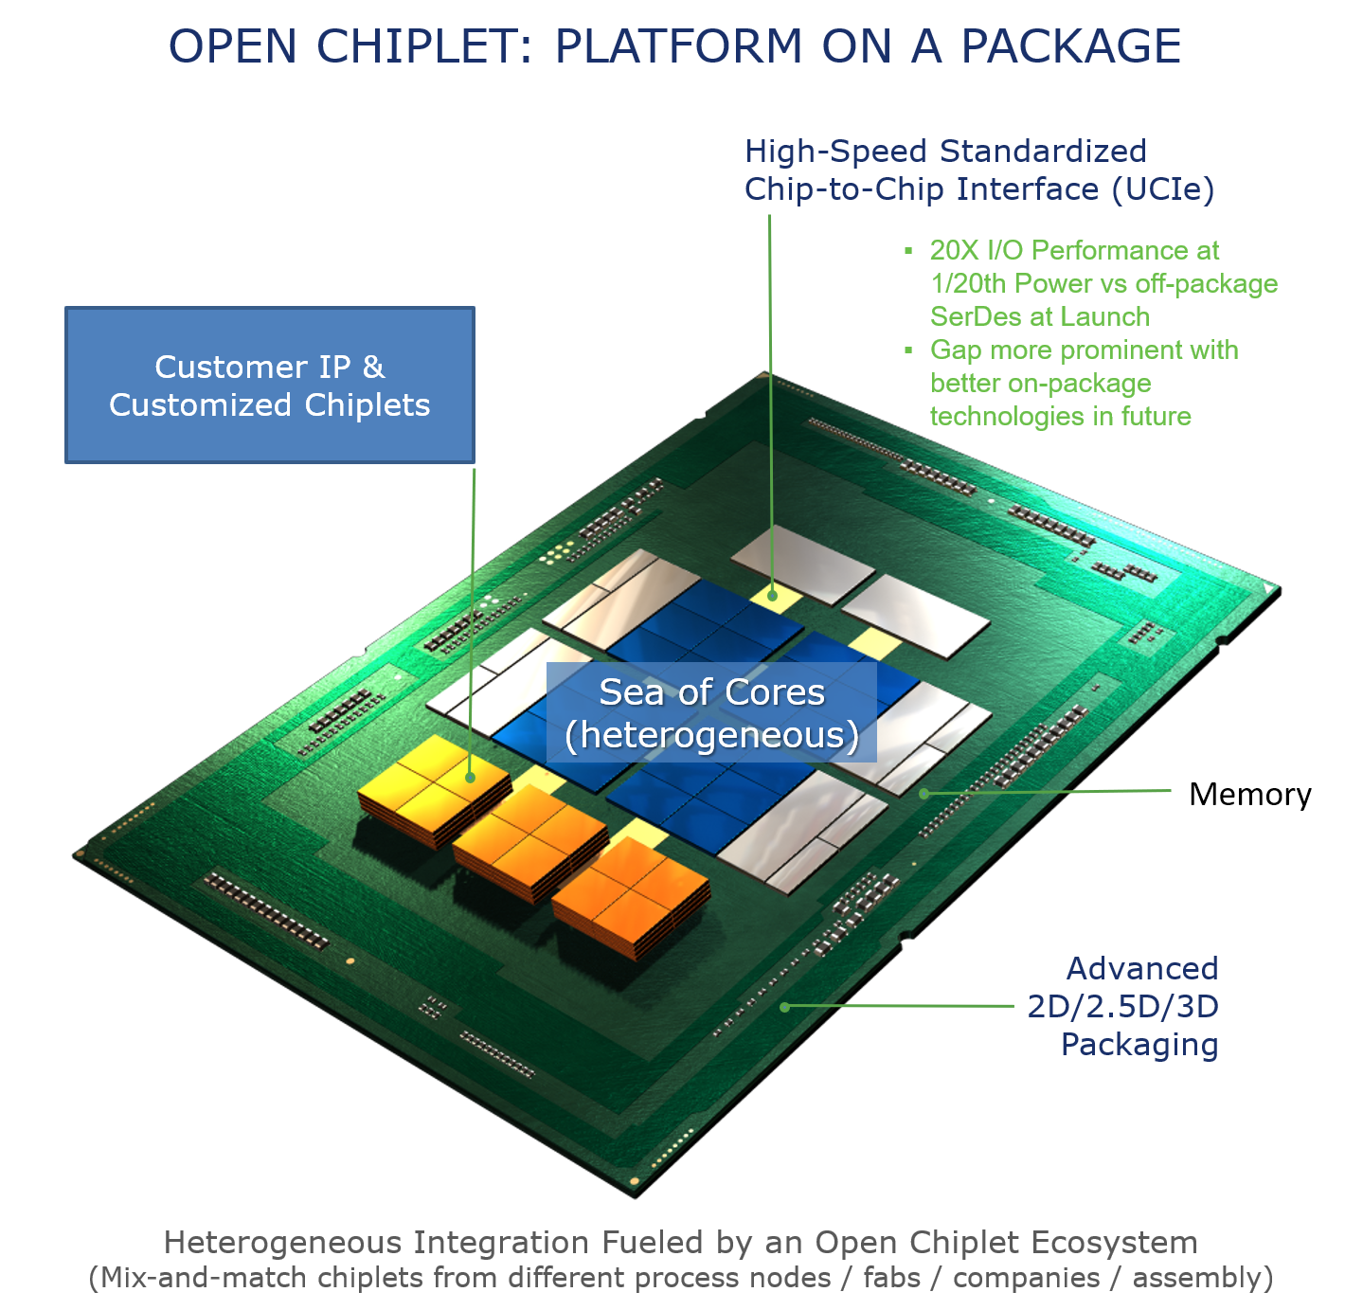
Benefits of Chiplets
Enables System-in-Package (SiP) devices that exceed max reticle size
Reduces time to solution
  Chiplet Reuse
Lowers Cost
  Use of optimal process technology
  Smaller die
  Chiplet reuse
Enables Specialization
Enables reuse of SW investment
“the package is the new motherboard”

Slide 6
Open Chiplet Ecosystem
Closed Single Vendor
System in Package (SiP) Solutions
Open Multi-Vendor Chiplet Ecosystem
System in Package (SiP) Solutions
Vendor A
Core
Core
Core
Vendor B
Vendor C
Chiplet
Chiplet
Chiplet
Apple M2
I/O
I/O Chiplet
Mem
Intel Xeon Max CPU
Hub and I/O
Chiplet
I/O
Chiplet
Mem
Chiplet
Vendor D
Accelerator
Accelerator
Accelerator
Chiplet
Chiplet
Chiplet
Vendor A
Custom Developed
Nvidia H-100 GPU
An Open Chiplet Ecosystem Requires Interoperability at Many Levels
  Vendor, Foundry, OSAT, IP Provider, Processor ISA, and System Architecture
An Open Chiplet Ecosystem Requires Open Standards with Open Access and Open Governance

Slide 7

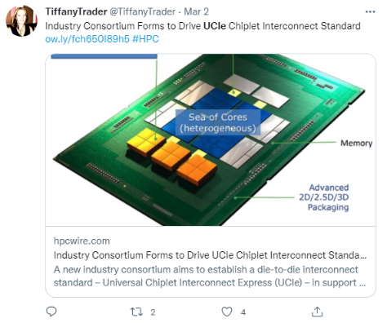
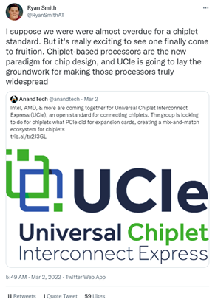
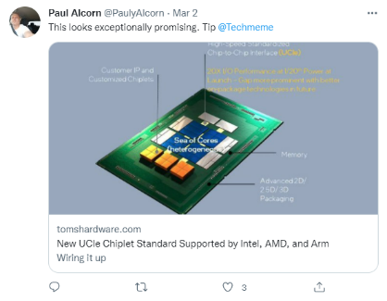




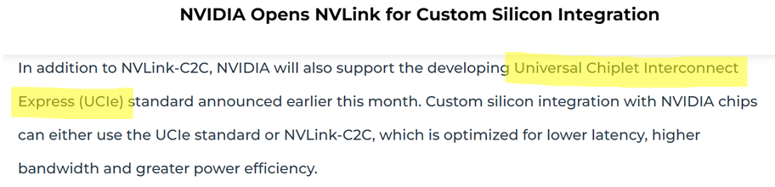








UCIe Consortium Announced (March 2nd 2022)
UCIe Board of Directors

Slide 8
Member Driven Evolution with Open Access and Open Governance
March
2022
June
2022
August
2023
August
2024
August
2025
UCIe Consortium
Incorporated
UCIe Consortium
formed
UCIe 1.1 Specification Released
UCIe 2.0 Specification Released
UCIe 3.0 Specification Released
UCIe 1.0 Specification Released
140+ Member Companies…and growing!

Slide 9
UCIe 2D and 2.5D Technology
SoC Die
Die #1
Die #2
Bump Pitch:
100 um to 130 um
Protocol Layer
Package Substrate
(PCIe or CXL)
Channel Reach:
Standard Package (2D)
10 mm (short reach)
Flit Aware D2D Intf. (FDI)
25 mm (long reach)
D2D Adapter
(ARB/MUX, CRC/Retry, Link State Mgmt.)
Die #1
Die #2
Raw D2D Intf. (RDI)
Package Substrate
Physical Layer
Silicon Bridge (e.g. EMIB)
Bump Pitch:
(Link Training, Repair, Lane Reversal, Scrambling)
25 um to 55 um
Die #1
Die #2
Channel Reach:
PHY
PHY
PHY
PHY
Module
Module
Module
Module
Interposer (e.g., CoWoS)
2 mm
Package Substrate
Supports speeds
up to 64 GT/s
Advanced Package (2.5D)
UCIe
UCIe
UCIe
UCIe
UCIe is Standardizing Everything Needed for An Open Chiplet Ecosystem
Bump Maps, Physical Layer, ISA Agnostic Protocols, Manageability & Security, System Architecture

Slide 10
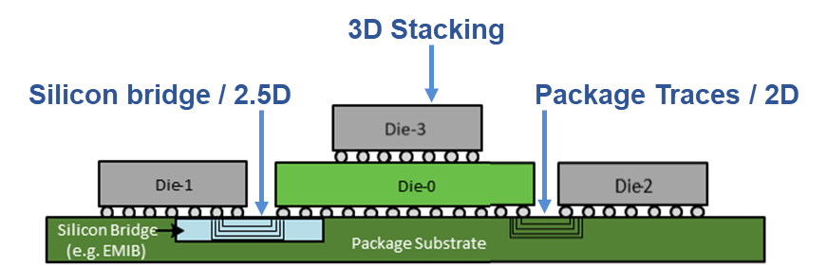
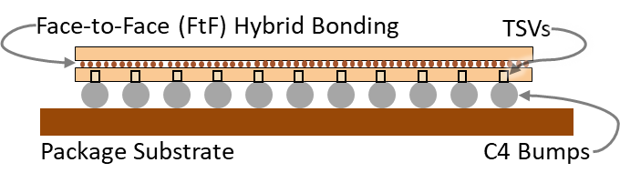
UCIe Key Characteristics and Metrics
Characteristics or Key Metric | UCIe-S (2D) | UCIe-A (2.5D) | UCIe 3D | Notes
Characteristics
Data Rate (GT/s) | 4, 8, 12, 16, 24, 32, 48, 64 |  | Up to 4 | UCIe 3D SoC Logic frequency – power efficiency is critical Added 48G and 64G with UCIe 3.0
Width (each cluster) | 16 | 64 | 80 | UCIe 3D: Options or reduced width to 70, 60…
Bump Pitch (µm) | 100 – 130 | 25 – 55 | < 10 (optimized) > 10 – 25 (functional) | Must scale so that UCIe fits within the bump area, UCIe-3D must support hybrid bonding
Channel Reach (mm) | < 25 | < 2 | 3D vertical | UCIe-3D: FtF, FtB, BtB, multi-stack possible
Target for Key Metrics
BW Shoreline (GB/s/mm) | 28 – 224 278, 370 | 165 – 1317 1975, 2634 | N/A (vertical) | For UCIe-S and UCIe-A: First row is for 4-32G. Second Row is for 48G and 64G respectively
BW Density (GB/s/mm²) | 22 – 125 144,192 | 188 – 1350 1235, 1646 | 4,000 (9µm) – 300,000 (1µm) | For UCIe-S and UCIe-A: First row is for 4-32G. Second Row is for 48G and 64G respectively
Power Efficiency Target (pJ/b) | 0.5 (<=16 G) 0.75 (>= 32 G) | 0.25 (<=12G) 0.3 (16G – 32G) 0.5 (>= 48G) | <0.05 at 9µm -> 0.01 at 1 µm
Low-Power Entry/Exit | 0.5nS < 16G, 0.5-1nS > 24G |  | 0nS | No preamble or post-amble
Reliability (FIT) | 0 < FIT (Failure in Time) << 1 |  | 0 < FIT << 1
ESD | 30V CDM |  | 5V CDM → < 3V | UCIe-3D: 5V CDM at introduction, no ESD for W2W hybrid bonding possible

Slide 11
UCIe Workgroups
01 CONNECT
02 COMMUNICATE
03 INTEROPERATE
Electrical & Physical
Protocol & Logical
Form Factor & Compliance
Physical die-to-die interface
Common communication model
Multi-vendor interoperability
Signaling, link behavior, data rates
2D, 2.5D, and 3D package evolution
Protocol architecture and transport
Flits, muxing, reliability, protocols such as PCIe/CXL/streaming
Bump map definitions and packaging requirements
Compliance methodology and test framework
04 SYSTEM ARCHITECTURE
05 DOMAIN READINESS
06 ADOPTION
Manageability & Security
Automotive
Marketing
Multi-chiplet system design
Application-specific ecosystem needs
Industry awareness and adoption
Discovery, configuration, telemetry, events, health
Secure provisioning and communication
Firmware activation, lifecycle management, power management
Automotive interoperability requirements
Reliability and scalable integration focus
Webinars, blogs, events, tutorials
Member engagement and ecosystem momentum
UCIe Workgroups are Defining the Complete Open Chiplet Ecosystem Stack

Slide 12
UCIe Electrical & Physical Layer
Zuoguo (Joe) Wu, Intel
UCIe Electrical Workgroup Co-Chair

Slide 13
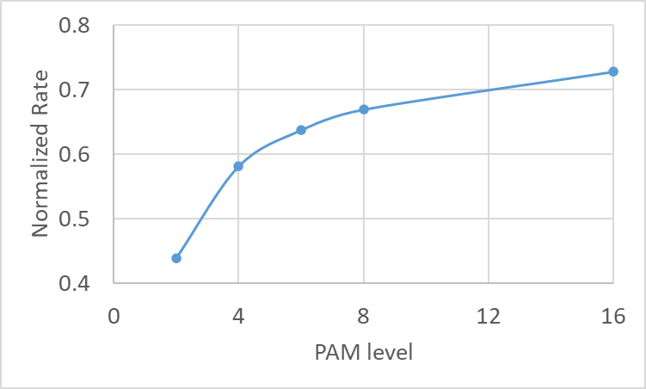
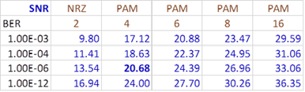
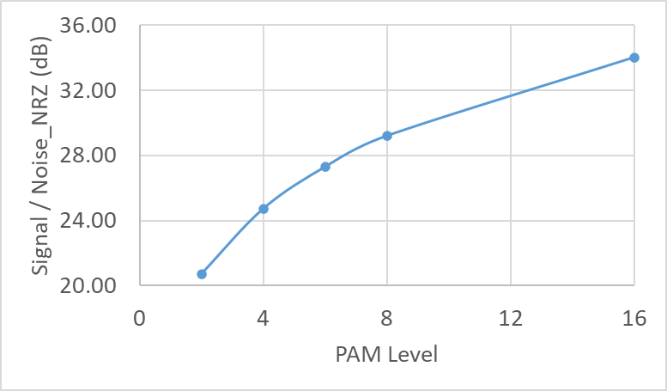
Signaling Method for Power Limited System
Data Rate at BER 1E-6 / Shannon Capacity
Theoretical Signal-to-Noise Ration (SNR)
Signal Power (BER 1E-27)
Normalized to NRZ Noise Power
On-package I/O is in a power limited, not channel bandwidth limited.
For a target data rate and given noise spectral density, PAM-N reduces the Baud rate, hence total noise. But it requires much higher SNR. Total power increases.
NRZ is the best choice for power in a low loss system

Slide 14
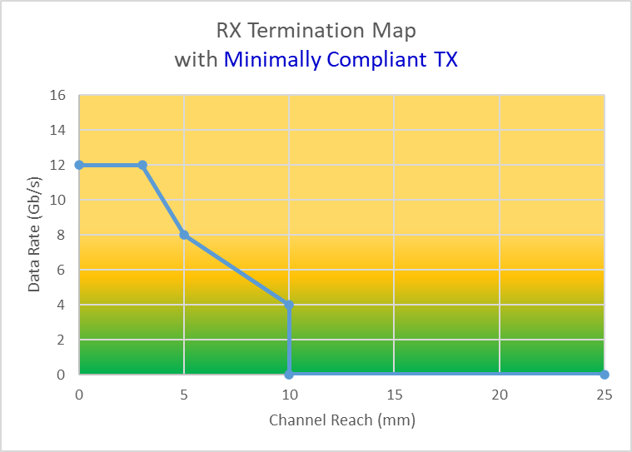
Data Rate and Channel Reach: UCIe 3.0 Example
Signaling: Unidirectional NRZ
Data Rate: 4, 8, 12, 16, 24, 32, 48, 64 Gb/s.
Channel Reach:
  Advanced Package (25-55um bump pitch):
    Up to 2mm reach at 32Gb/s with TX drive control
    No RX Termination ≤ 32 Gb/s, with RX Termination @ 48/64 Gb/s.
  Standard Package (100-130um bump pitch):
    TX Termination
    RX Termination Map
Terminated
Unterminated
Reach for unterminated RX can be increased with higher swing TX

Slide 15

Termination Power
For power efficiency in pJ/b, termination power overhead reduces with higher data rate (fixed total energy cost).
At 64GT/s power overhead is < 0.05 pJ/b for adding 50 Ω termination
  Table calculated with ideal channel, max 0.85V swing, TX_Rterm = 30 Ω, TX_Cpad = 125fF and RX_Cpad = 125fF.
$$E\left(\frac{pJ}{b}\right)=\frac{V_{dd}^{2}}{4}\left[\frac{1}{\left(R_{TX}+R_{RX}\right)F}+\frac{\left(C_{TX}+C_{RX}\right)R_{RX}^{2}}{{\left(R_{TX}+R_{RX}\right)}^{2}}\right]$$
As data rates go higher, the cost reduces while the (SI) benefit increases.

Slide 16
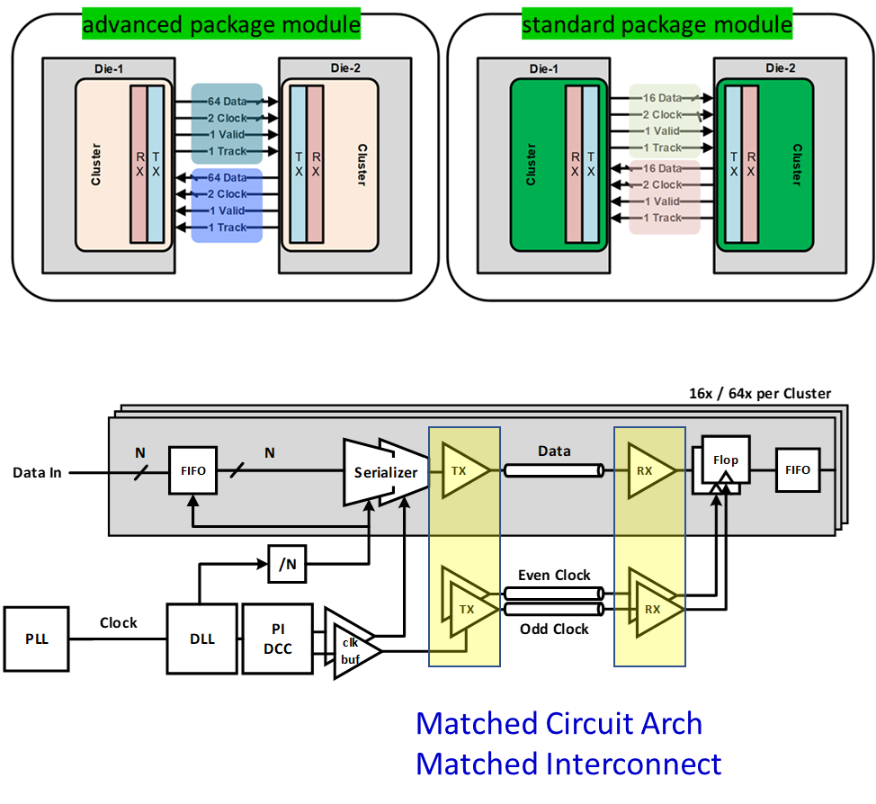
UCIe PHY Architecture and Features
Low Datapath Latency: 12 UI @ ≤16Gb/s, 16 UI @ 24-32Gb/s, 24 UI @ 48Gb/s, 32 UI @ 64Gb/s.
  @16Gb/s ≤ 2ns when including adapter
Ultra Fast Idle Exit (L0-idle): ≤ 1ns, orders of magnitude faster than typical off-package serial I/O.
Valid Framing and Re-timer support, Hamming distance 4 encoding to improve reliability.
L1 power state (options for further power down)
Redundancy & Repair for Advanced Package
  Two per 32 bits
Data Scrambling to mitigate power supply noise
  Does not require extra pin, unlike DBI.
Tightly-Coupled Mode for further optimization (when supported by channel)

Slide 17
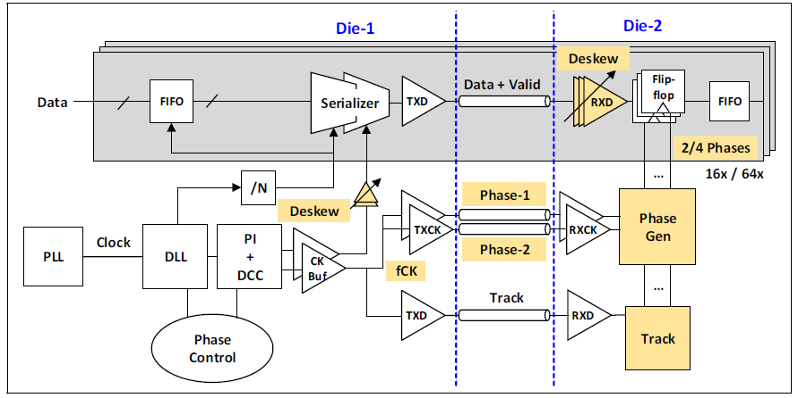
D2D PHY Clocking
Forwarded Clock PHY architecture offers significant benefit with reasonable overhead
  The trade-offs differ significantly from off-package links
To support broad data rate ranges:
  Enable 2-way and 4-way interleaving TRX
  Independent even/odd phase control
  3 levels of phase adjustments (global TX, local TX, local RX) depending on data rate
UCIe specific features:
  Data Valid bit to gate clock distribution (also for data framing)
  Track bit for background training and phase alignment

Slide 18
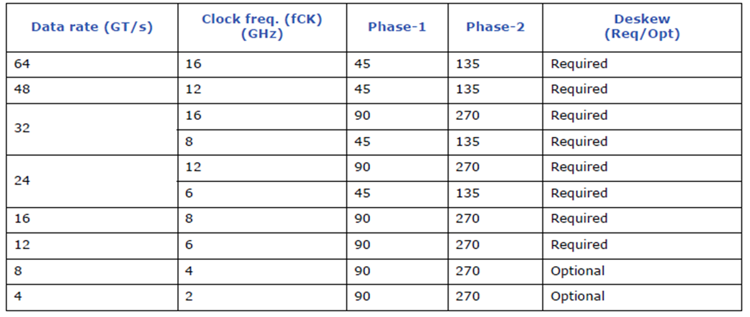
Forwarded Clock Frequency and Phase
Different data rate can lead to different optimal forwarded clock configurations. Table above is from UCIe, but the principle applies to general D2D.
Additional features for 48-64 Gb/s:
Continuous free running forwarded clock
  At these speeds, the cost of maintaining a fast on/off strobe outweighs its benefit.
In-phase/Quadrature (I/Q) correction

Slide 19
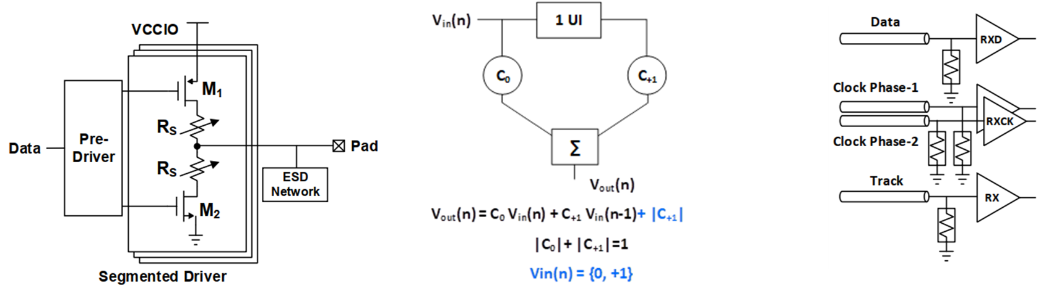
Driver and Input Buffer
Typical segmented TX driver. CMOS implementation shown. NN driver and other structure possible.
TX de-emphasis required at 24+ GT/s.
  Trained at link initialization, real-time adaptation is not required.
RX Termination (when applicable) to ground
Does not mandate a specific input buffer design. If RX amplifier is used, recommend bandwidth > 0.75x data rate (1.5x Nyquist).
Notes:
TX de-emphasis equation is the classical version modified for Single-Ended, hence looks different.

Slide 20
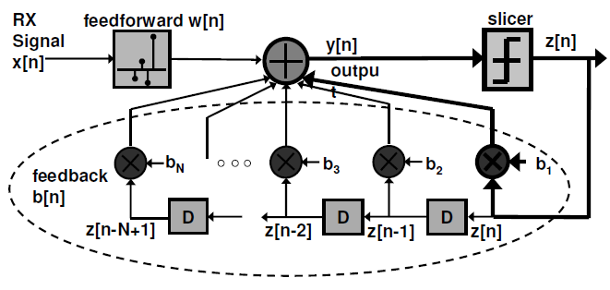
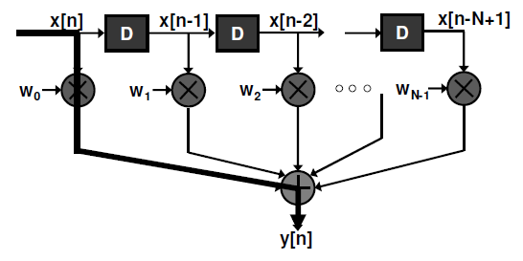
Enhanced Equalization for 48-64 Gb/s
Multi-tap TX FFE
Avoid complex back-channel adaptation if possible. Often, fixed presets are sufficient.
RX DFE illustration
  Many design choices to address critical timing path
  Feedforward is often in the form of CTLE

Slide 21
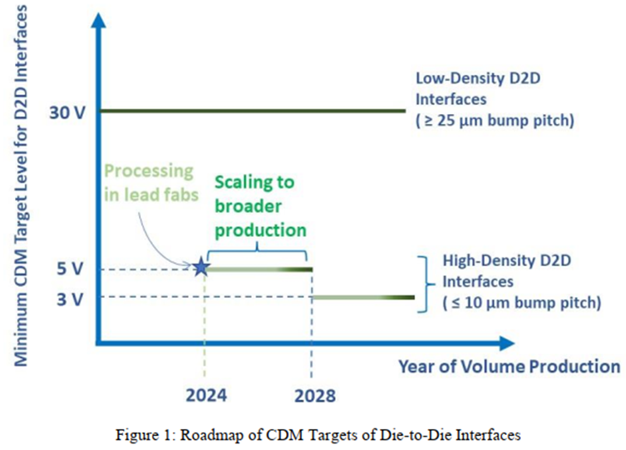
Pad Capacitance and ESD
Pad Capacitance (Cpad) has a 1st order impact on performance
D2D PHY must aggressively reduce Cpad and ESD without compromising reliability
UCIe ESD spec: 30V CDM, further scaling in future, align with Industry Council on ESD Targets.
TX/RX Pad Capacitance | 250/200 | fF | Advanced Package Mode
TX/RX Pad Capacitance (8Gb/s capable design) | 300 | fF | Standard Package Mode
TX/RX Pad Capacitance (16Gb/s capable design) | 200 | fF | Standard Package Mode Effective Cpad
TX/RX Pad Capacitance (32Gb/s capable design) | 125 | fF | Standard Package Mode Effective Cpad
http://www.jedec.org reference JEP196
http://www.esdindustrycouncil.org/ic/en or http://www.esda.org reference White Paper 2 Part II

Slide 22
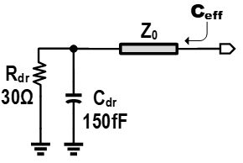
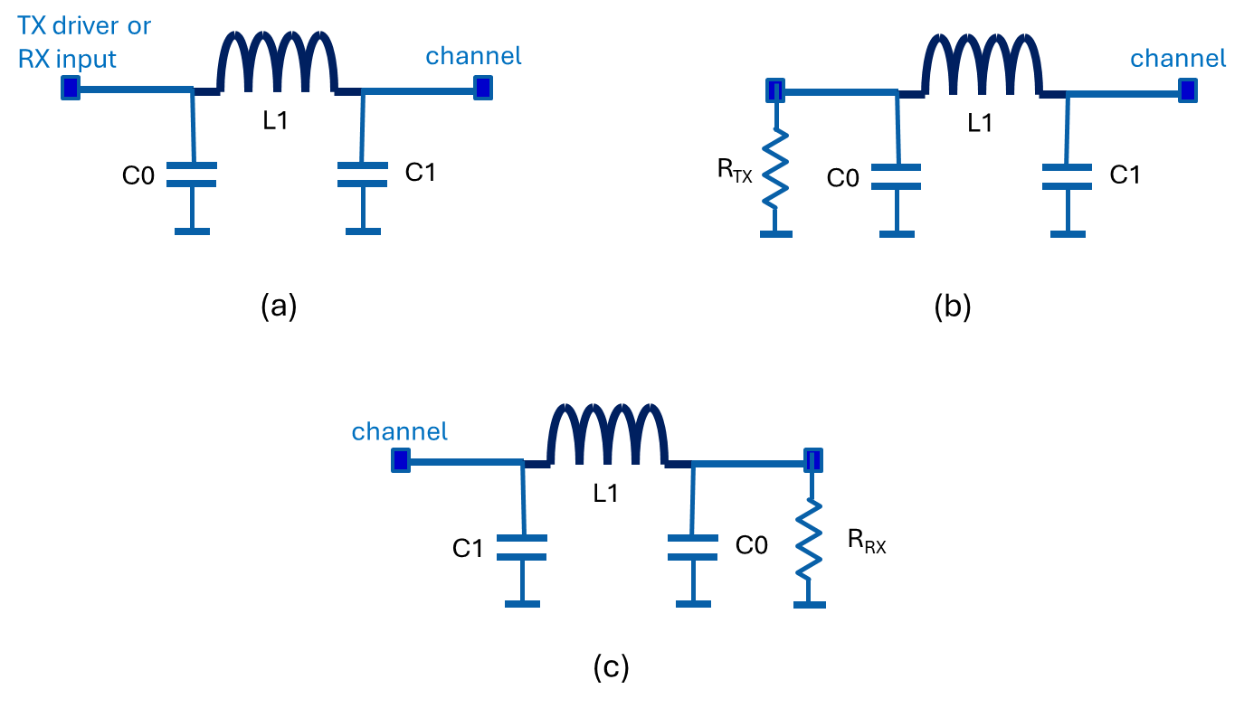
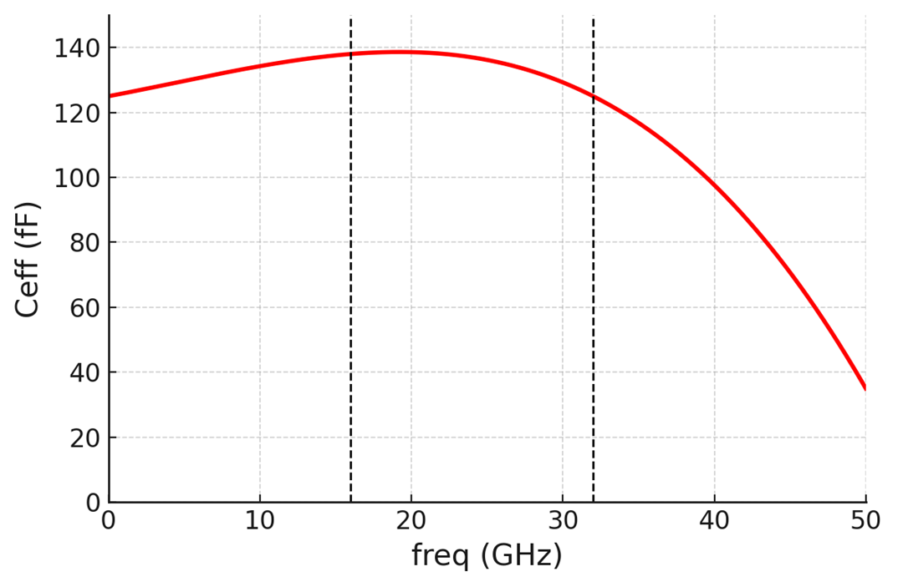
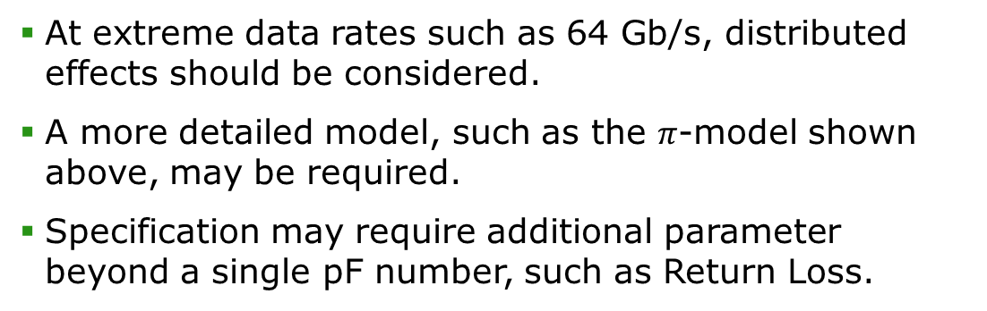

High-Speed Distributed Effect
O(100µm)
At extreme data rates such as 64 Gb/s, distributed effects should be considered.
A more detailed model, such as the $π$-model shown above, may be required.
Specification may require additional parameter beyond a single pF number, such as Return Loss.
$$ReturnLoss \left(dB\right)=10\log_{10}{\frac{P_{i}}{P_{r}}}= −20\log_{10}\left|S_{11}\right|$$

Slide 23
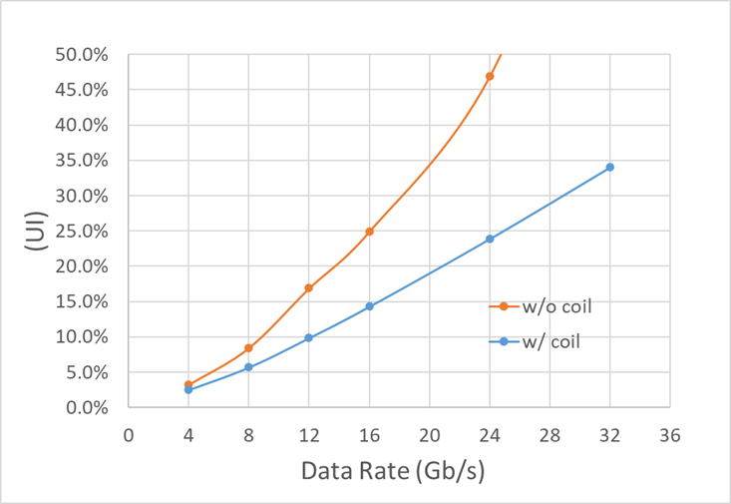
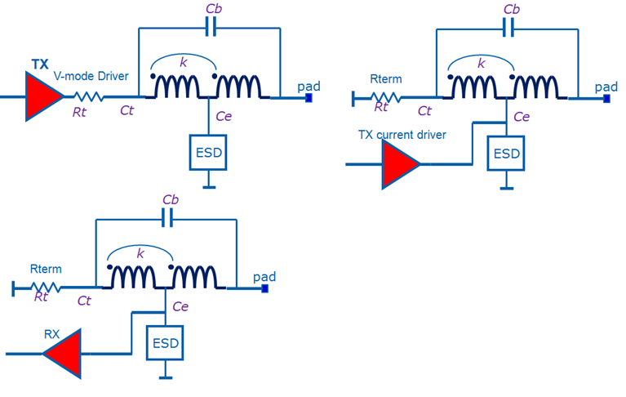
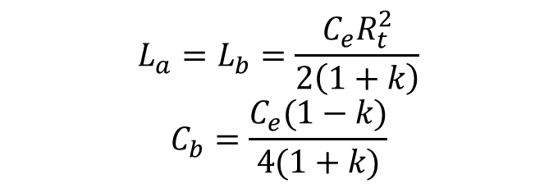
Cpad/ESD Mitigation
T-coil impact to standard package channel
TX T-coil
RX T-coil
TX T-Coil can achieve broadband Cpad/ESD reduction.
Theoretical Advantage: "Ce" can be zeroed out, though practical factors may influence results.
T-coil size expected to be on the order of 20µm x 20µm x 2
$$L_{a}=L_{b}=\frac{C_{e}R_{t}^{2}}{2\left(1+k\right)}$$
$$C_{b}=\frac{C_{e}(1−k)}{4(1+k)}$$

Slide 24
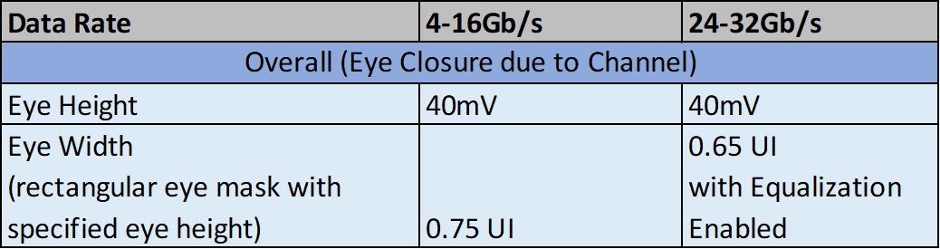
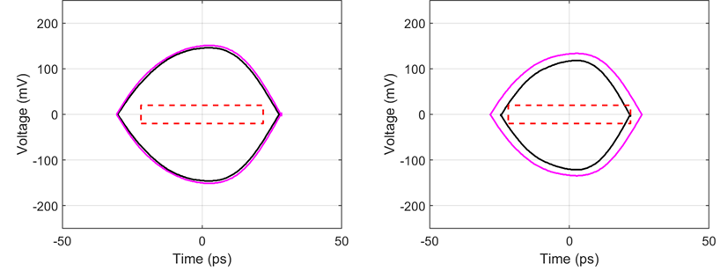
Interconnect Channel Specification
Channel needs to meet minimum eye mask under channel compliance simulation with noiseless jitter-less behavioral TX and RX models.
Pass/fail eye mask example
Insertion loss and Crosstalk spec defined based on the criteria using Voltage Transfer Function (VTF) method
  Due to short transmission line, VTF is more practical than S-parameter based method.

Slide 25
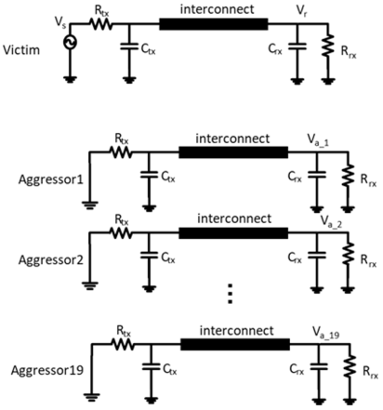
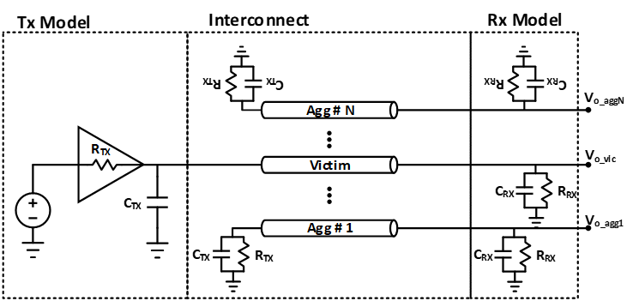
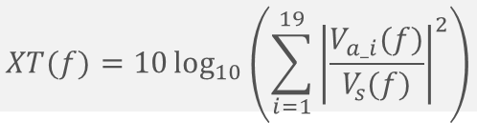
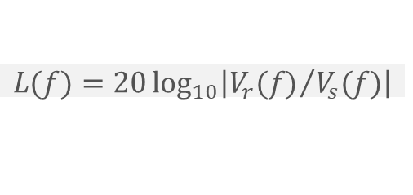
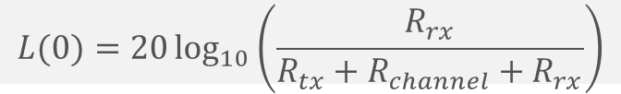
Voltage Transfer Function (VTF) Based Metrics
Circuit for VTF
VTF metrics incorporates Tx and Rx R/C terminations
Loss
Loss is defined as the ratio of the receiver voltage and source voltage
$$L(f)=20\log_{10}\left|{V_{r}(f)}/{V_{s}(f)}\right|$$
$$L(0)=20\log_{10}\left(\frac{R_{rx}}{R_{tx}+R_{channel}+R_{rx}}\right)$$
$L\left(0\right)$ is 0 for unterminated channel
Eye Mask
Simulation Setup
Crosstalk
19 aggressors included
Crosstalk is defined as the power sum of the ratios of the aggressor receiver voltage to the source voltage
Based on crosstalk reciprocity
$$XT(f)=10\log_{10}\left(\sum_{i=1}^{19}{{\left|\frac{V_{a_i}(f)}{V_{s}(f)}\right|}^{2}}\right)$$

Slide 26
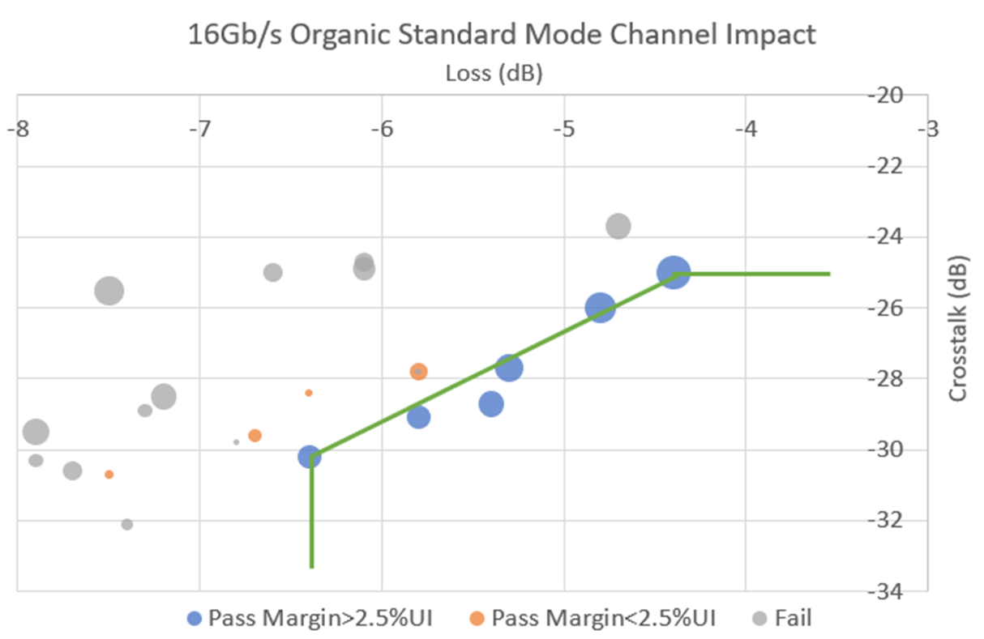
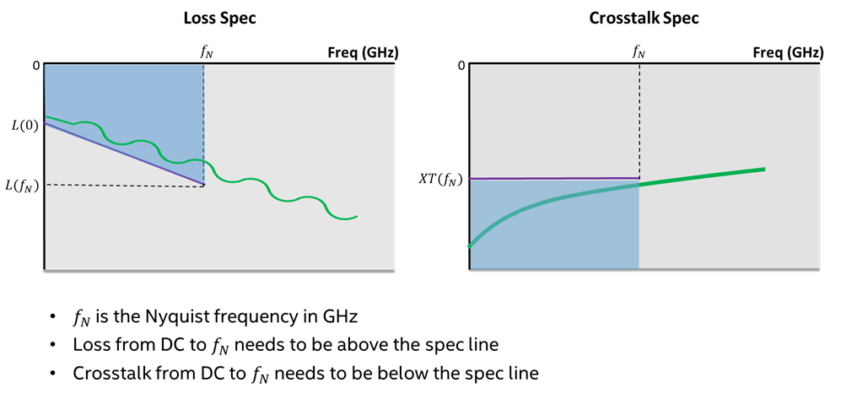
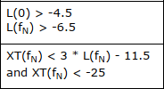
Specify Insertion Loss, Crosstalk & Tradeoff
Example of UCIe at 16Gb/s standard package shown: 2D map of L(8) and XT(8) pass/fail region
Linear and flat mask for Loss and Crosstalk respectively, not a single frequency spec.

Slide 27
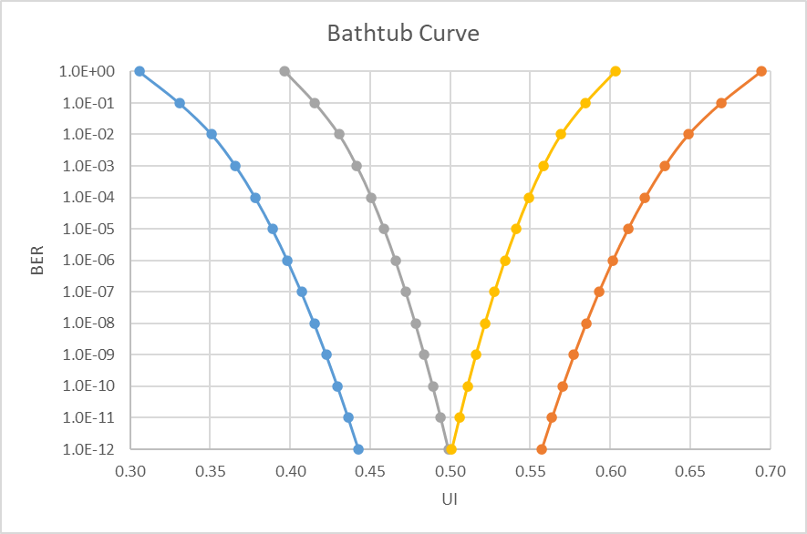
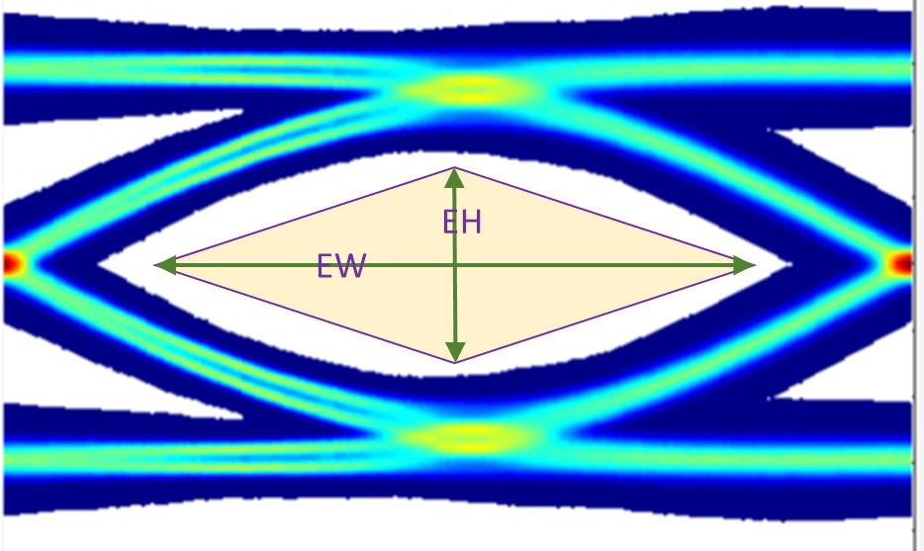
Eye Mask for 48 and 64 Gb/s
Diamond Shape Eye Mask is required when data rate reaches certain point
  Eye Mask includes effects of channel loss profile, xtalk, and link equalization. Does not include circuit noise, jitter, and other non-idealities.
(+) Provides more channel solution space than rectangular eye mask
(!) Cannot decouple Eye Width and Eye Height calculations
(!) Need to consider voltage noise and timing jitter interaction in link analysis
(!) Statistical method required

Slide 28
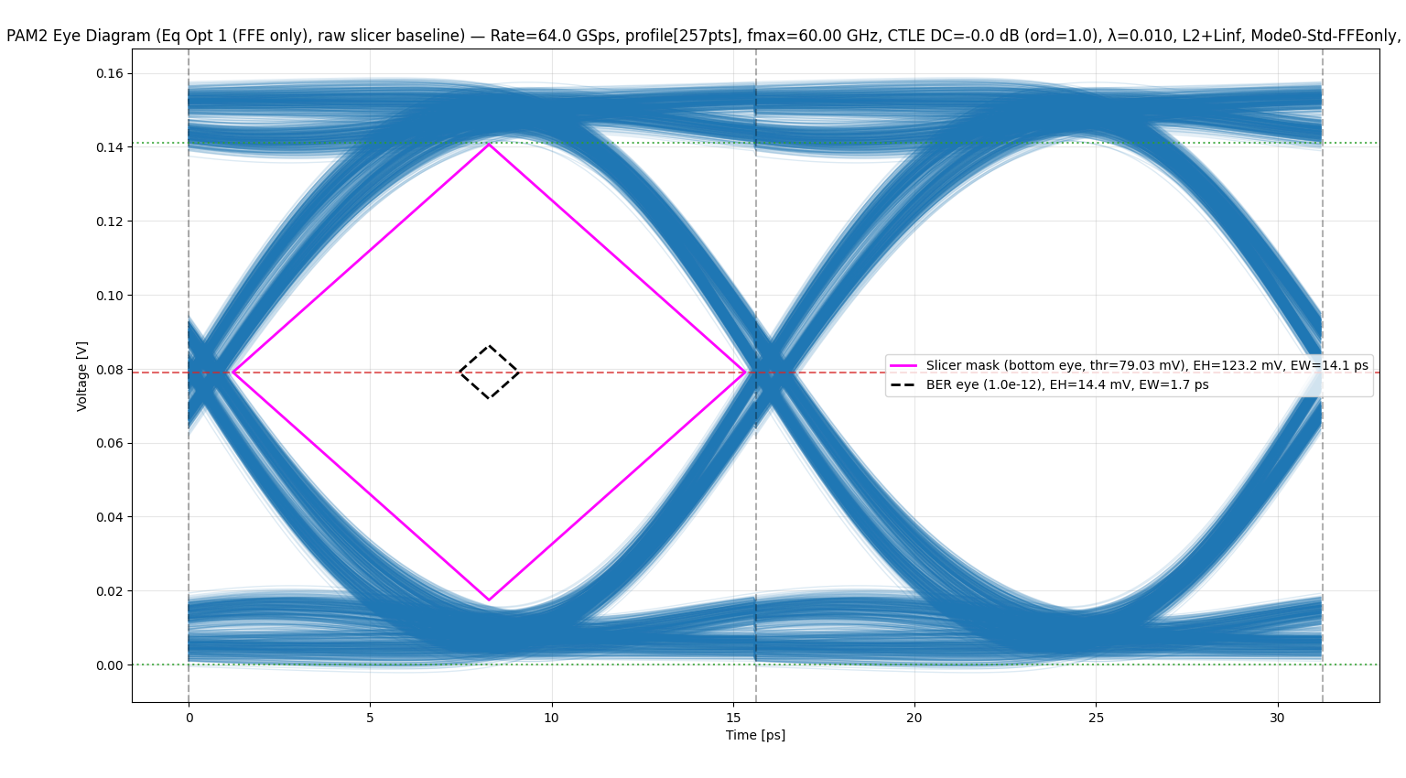
Statistical Method Example
Channel: representative UCIe-S link, 10.4 dB insertion loss at 32 GHz
Outer Eye: the response after the channel, with equalization applied
Inner Eye (BER 1E-12): adds Xtalk, noise, jitter (random and deterministic), mismatch, and training error
Versus high-speed SerDes: a cleaner starting eye from loss and EQ, but far greater closure from circuit non-idealities

Slide 29
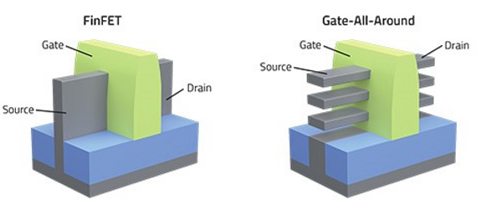
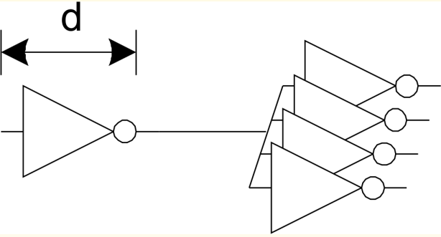
On Process Scaling
FinFET transitioned to GAA FET (or equivalent)
  GAA has improved digital performance (higher drive current, lower leakage…), but may have analog design challenges.
Make front-end circuits more digital like and minimize pure analog circuits. Do not require special analog process.
  Traditionally analog circuits such as DLL and phase interpolator can be implemented with digital approach.
Fan-out of 4 (FO4) inverter delay d is often used to characterize IO feasibility
  Baud rate ≤ 1/(4d) : relatively simple IO; digital approaches are feasible (UCIe region)
  Baud rate between 1/(4d) and 1/(2d): high complexity serial IO
  Baud rate > 1/(2d) : very complicated highly analog if possible

Slide 30
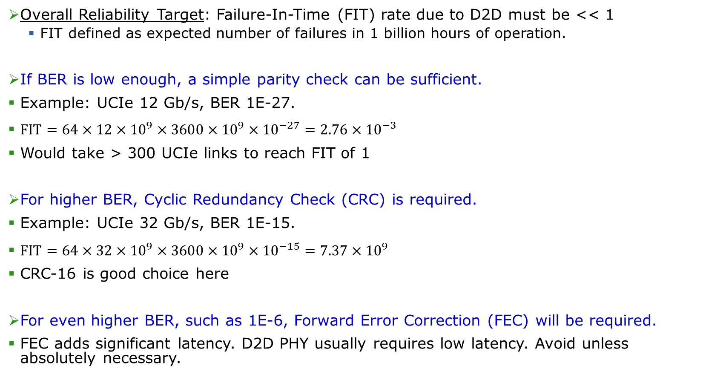
Failure-In-Time
Overall Reliability Target: Failure-In-Time (FIT) rate due to D2D must be << 1
  FIT defined as expected number of failures in 1 billion hours of operation.
If BER is low enough, a simple parity check can be sufficient.
Example: UCIe 12 Gb/s, BER 1E-27.
$FIT=64×12×{10}^{9}×3600×{10}^{9}×{10}^{−27}=2.76×{10}^{−3}$
Would take > 300 UCIe links to reach FIT of 1
For higher BER, Cyclic Redundancy Check (CRC) is required.
Example: UCIe 32 Gb/s, BER 1E-15.
$FIT=64×32×{10}^{9}×3600×{10}^{9}×{10}^{−15}=7.37×{10}^{9}$
CRC-16 is good choice here
For even higher BER, such as 1E-6, Forward Error Correction (FEC) will be required.
FEC adds significant latency. D2D PHY usually requires low latency. Avoid unless absolutely necessary.

Slide 31
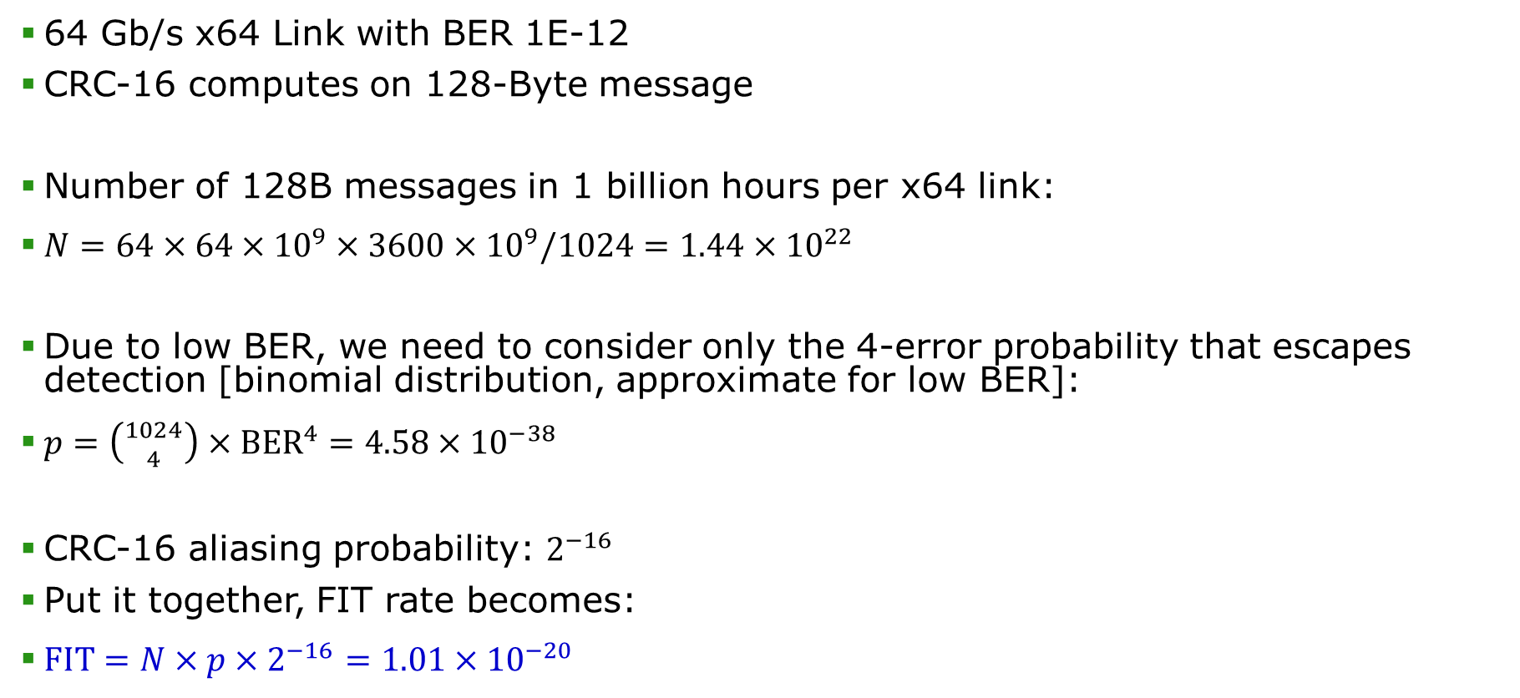
Example CRC Computation
64 Gb/s x64 Link with BER 1E-12
CRC-16 computes on 128-Byte message
Number of 128B messages in 1 billion hours per x64 link:
$N=64×64×{10}^{9}×3600×{10}^{9}/1024=1.44×{10}^{22}$
Due to low BER, we need to consider only the 4-error probability that escapes detection [binomial distribution, approximate for low BER]:
$p=\left({1024 \atop 4}\right)×{BER}^{4}=4.58×{10}^{−38}$
CRC-16 aliasing probability: $2^{−16}$
Put it together, FIT rate becomes:
$FIT=N×p×2^{−16}=1.01×{10}^{−20}$
We have some margin to spare

Slide 32
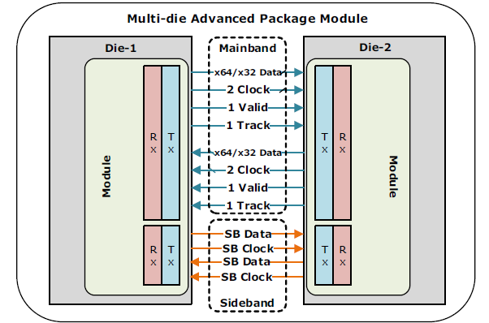
In-Field Repair Strategy – A case study
For advanced package, some physical connections may fail due to high density and large number of interconnects.
In-field Repair becomes critical.
Each of TX or RX cluster has the following repair capability:
  Option 1: 2 repairs for each of 32 the data lanes (baseline)
  Option 2: 4 repairs for total 64 data lanes
  Option 3: option 1 + half width when > 2 failures in 32 lanes
Common for all options:
  1 repair for CKP, CKN, Track
  1 repair for Valid
  1 repair for SB Data
  1 repair for SB Clock
A Module fails if defect number exceeds repair resources
Notes:
Include automotive slide?

Slide 33


Module Failure Probability
Option 1:
Option 2:
Option 3:
  Half BW probability $P_{1}−P_{3}$
𝑝∈[0,1] is the failure rate of an individual lane, and 𝐹(𝑚,𝑛,𝑝) is the cumulative binominal distribution function.
$$P_{1}=1−{\left(1−p^{2}\right)}^{6}{F\left(1,4,p\right)}^{2}{F(2,34,p)}^{4}$$
Counting failures in both directions
TX and RX bundles
Valid
SB Data/Clock
CLKP/N
Track
Data Lanes
$$P_{2}=1−{\left(1−p^{2}\right)}^{6}{F\left(1,4,p\right)}^{2}{F(4,68,p)}^{2}$$
$$P_{3}=1−{\left(1−p^{2}\right)}^{6}{F\left(1,4,p\right)}^{2}{F\left(2,34,p\right)}^{2}{\left[2−F(2,34,p)\right]}^{2}$$
2 arises from $1−{\left(1−F\right)}^{2}=F(2−F)$

Slide 34
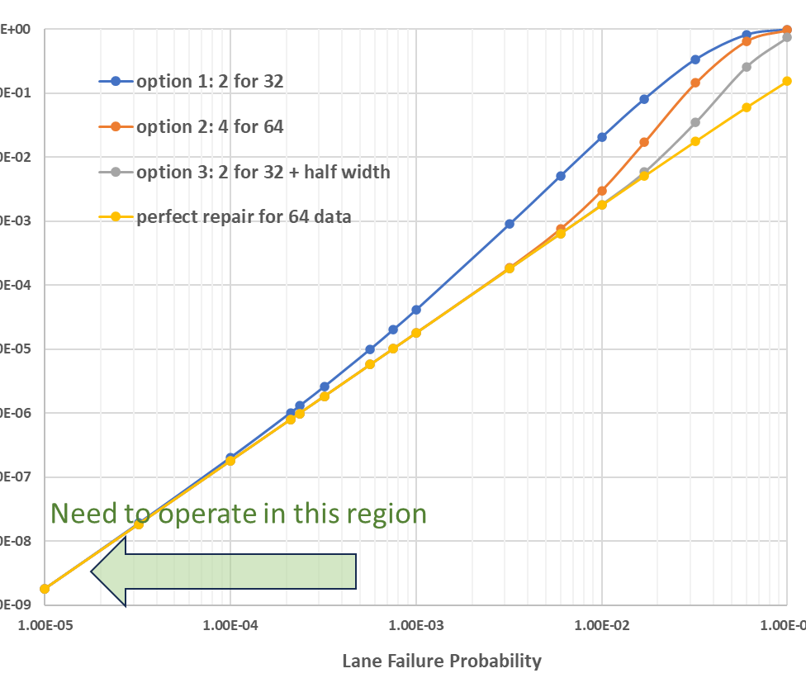
Module Failure Probability Plot
Raw fail rate required to meet post-repair ppm:
Plot as a function of lane failure probabilities
Hypothetical perfect repair case: data lanes never fail, only Valid/Clock/Track/SB can fail.
Differences between all options are minimal in the practical region, even though options 2, 3, and 4 appear better on paper.
Takeaway:
It’s critical to identify the bottleneck
Poor ROI if addressing the wrong set

Slide 35
UCIe Protocol & Logical Layer
TBD, TBD
UCIe Protocol Workgroup Co-Chair

Slide 36
UCIe Protocols
UCIe defined protocol support
  PCIe
  CXL
  UCIe Management Transport Protocol with UCIe Memory Access Procol
  Streaming: Vendor defined protocol
Multiple Flit formats are permitted as a transport mechanism
Raw formats are supported where D2D Adapter CRC/Retry is bypassed – supported for all protocols

Slide 37
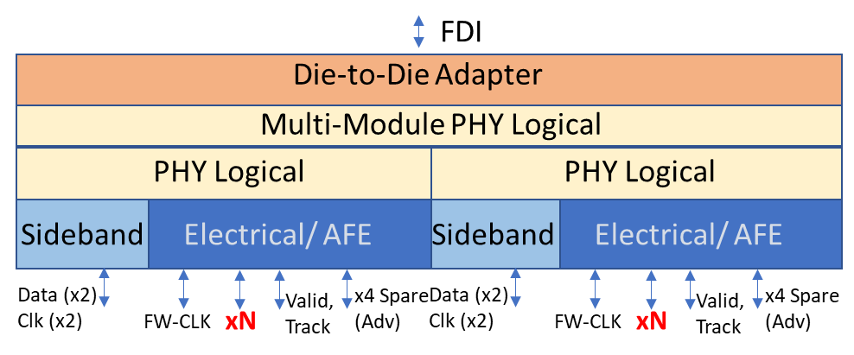
Functionality Partitioning
Protocol Layer:
  Streaming : Vendor Defined
  PCIe/CXL
  Flit format adherence, Transaction Layer credits etc.
Adapter
  Lightweight CRC computation – 16b over 128B
  Flit Retry mechanism leveraged from PCIe Flit Mode
Logical Physical Layer:
  Link State Management for Reset/Active/PM/Error flows
  1, 2 or 4 modules can be aggregated for a single UCIe Link
2 Module Example

Slide 38
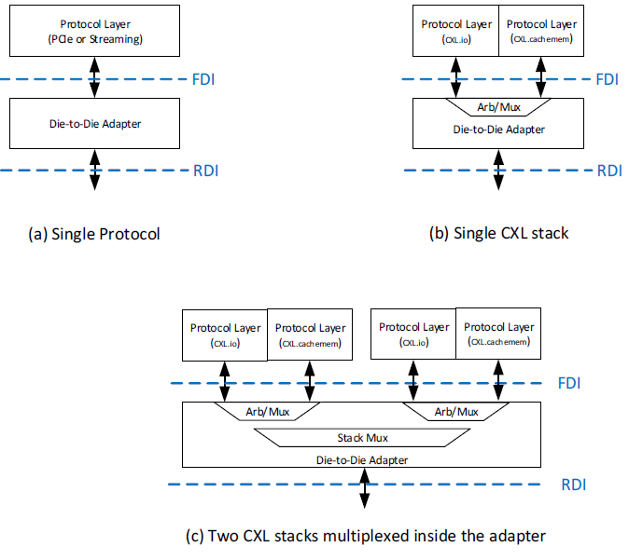
Example Configurations

Slide 39
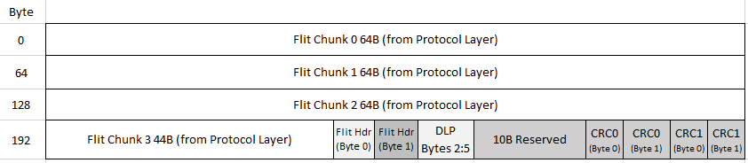
Supported Flit Format example – PCIe Flit Mode
Protocol Layer sends the Flit over FDI, drives 0b on reserved bits and the bits filled in by the D2D Adapter (Flit Marker populated by Protocol Layer in DLP Bytes 2:5)
  DLLPs sent/received over separate signals on FDI
D2D Adapter fills in DLLP into DLP Bytes 2:5 if Flit Marker is not present

Slide 40
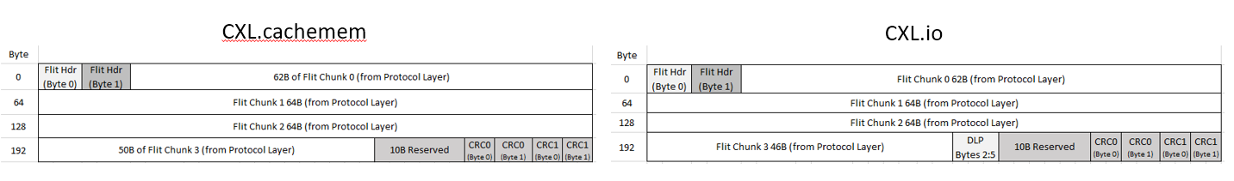
Flit Format example – CXL 256B Flit Mode
Protocol Layer sends the Flit over FDI, drives 0b on reserved bits and the bits filled in by the D2D Adapter
  For CXL.io, Flit Marker populated by Protocol Layer in DLP Bytes 2:5. DLLPs sent/received over separate signals on FDI. D2D Adapter fills in DLLP into DLP Bytes 2:5 if Flit Marker is not present
  For CXL.cachemem, there are no DLP bytes in the Flit, the corresponding bytes of the Flit are used for Payload instead
Follows the Framing rules for the Standard Flit in CXL Specification

Slide 41
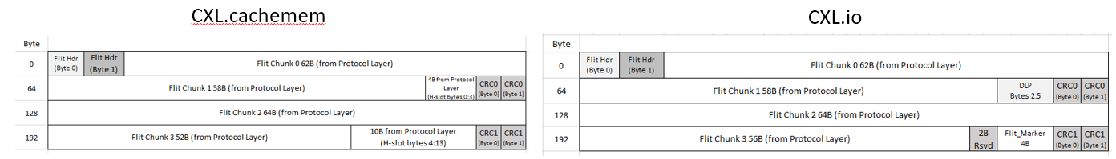
Flit Format example – Latency optimized CXL with optional bytes
Protocol Layer sends the Flit over FDI, drives 0b on the bits filled in by the D2D Adapter
  For CXL.io, Flit Marker populated by Protocol Layer in DLP Bytes 2:5. DLLPs sent/received over separate signals on FDI
  For CXL.cachemem, there are no DLP bytes in the Flit, the corresponding bytes of the Flit are used for payload
Follows the Framing rules for Latency Optimized Flit in CXL Specification with additional bytes from Protocol Layer for added efficiency
  CXL.io gets an extra DWord of TLP information
  CXL.cachemem gets an extra 14 Bytes of payload (H-slot)

Slide 42

Flit Format example - Streaming
Streaming can use any of the available Flit Formats.
Common applications use the Latency Optimized one with optional bytes shown here

Slide 43

Continuous Transmission Protocols (Raw Mode Example)
Function: High-speed data transmission protocols between data converters (ADCs and DACs) can be mapped to UCIe Raw Mode of operation
  Run link at same data rate as data generation/ consumption
  No need for separate PLLs
  Avoids introducing additional frequency noise in sensitive analog circuits
  Need periodic synchronization markers, parity
UCIe’s Approach:
  Use existing raw mode with enhancements to the internal RDI / FDI interface
  encodings in Valid to send periodic synchronization markers and parity (full use of all data lanes which is desired)
  Support range of frequencies
    System designer controls the data rate by varying the REFCLK
    Compliance only performed for the UCIe data rates

Slide 44



Off-package connectivity w/ Retimers to other media (e.g. Optics)

Slide 45
Logical Physical Layer

Slide 46
Functionality
Byte to Lane mapping for data transmission over Lanes
  Separate Valid Lane for indicating data transfer
Interconnect redundancy remapping for Advanced Package configurations
Width degradation support for Standard Package Configurations
Scrambling and training pattern generation
Lane reversal
Link initialization, training and power management states
Transmitting and receiving sideband messages

Slide 47

Link Training State Machine
Sideband (SB) initialization
  Initialization and repair (advanced package) of SB
Mainband (MB) initialization
  Parameter exchange, Clock, Valid & MB repair & MB reversal
Mainband training
  Data training, at speed repair/degrade and speed degrade
LINKINIT
  Exchange RDI Link management messages
PHYRETRAIN: Retrain based on Link errors
  Allow repair or degrade
L1/L2: Lower power state
TRAINERROR: For uncorrectable internal errors and Link down conditions
Active: Transactions are sent and received

Slide 48
Software view of UCIe

Slide 49
Software view of integrated device
Host
  UCIe links discoverable by OS through UCIe Early Discovery Table (UEDT ¹) populated by FW
  UCIe link details enumerated via new Link-DVSEC capability in Host-specific Register Block (UiRB)
EP/Switch USP
  UCIe enumerated via new DVSEC capability in EP/USP Dev0/Fn0
Industry standard PCIe/CXL SW model for UCIe enumeration and control

Slide 50

UCIe Link DVSEC – For basic Link Functionality
New UCIe DVSEC with UCIe Consortium ID of 0xD2DE
UCIe Link Capabilities, Control, Status
  Link width/speed, Stack support, Packaging type, (re)train Etc.
Error/Link Event Notification Control/Status
Register Locators
  For registers beyond the basic functionality in DVSEC – Test/Compliance, Implementation specific, D2D/PHY
Mailbox
  For sideband access of far-side chiplet’s UCIe registers, for debug
Associated DevFn
  For enumerating interdependent RP/DSP links in a multi-stack UCIe scenario

Slide 51
UCIe Form Factor & Compliance
Gerald Pasdast, Intel
UCIe Form Factor & Compliance Workgroup Co-Chair

Slide 52
Outline
UCIe Form Factor
  UCIe-S
  UCIe-A
  UCIe-3D
UCIe Compliance

Slide 53


UCIe-S (2D): Standard Package Bump Maps
Two options: x16 and x32 bump arrangements for BW/mm flexibility
  424 recommended package stack-up for x16 (two topside stripline routing layers)
  828 recommended package stack-up for x32 (4 topside stripline routing layers) for doubled BW/mm
x32 module
x16 module

Slide 54






UCIe-S: Arrangement & Channel Characteristics
UCIe-S
  Single and Double-stack arrangements allowed
  Checkerboard RX/TX arrangement for die rotate/universal interop
power
ground
signals on L8
signals on L6
signals on L4 and L2 not shown
18 io/mm/layer
2 routing layers for each module
4 routing layers for 2 modules
VTF Loss
Cumulative VTF Crosstalk
32Gb/s Eye Diagram
25mm length
Voltage Transfer Function (VTF)

Slide 55
UCIe-A (2.5D): Advanced package Bump Maps
Bumpout configurations for maintaining optimized BW/mm² across allowable bump pitch range
  8, 10 and 16-columns
  Suggested usage guideline:
BP | Max Data Rate by Spec | Columns within 388.8 shoreline
25-30 | 12 | 16
31-37 | 16
38-44 | 24 | 10
45-50 | 32
51-55 | 32 | 8
16Col
Recommended for
25-37um bump pitch
die edge
die edge
die edge
10Col
Recommended for
38-50um bump pitch
8Col
Recommended for
51-55um bump pitch

Slide 56




UCIe-A: Arrangement & Channel Characteristics
UCIe-A
  TX close to shoreline/RX stacked behind
  Lane reversal critical for universal rotate/mirror/interop
VTF Loss
Cumulative VTF Crosstalk
16 Gb/s Eye Diagram
40mV x 50ps
Voltage Transfer Function (VTF)

Slide 57

UCIe-3D Menu / Options
Side View
Face-to-Face Hybrid Bonding
TSVs
Bump Pitch: 1um ~ 25um, same pitch TX to RX.
  1um ~ 9um pitch - Optimized w/ circuit & Hybrid Bonding tech
  10um ~ 25um pitch. - Supported functionally. (future revision)
Assemble Technology / Channel:
  Face to Face bonding (F2F, Baseline). NoC/switches for multi-layer stack
  Face to Back bonding (F2B). Multi-layer stack directly with max data rate reduction (10-20%)
Area (with 9um pitch): ~ 0.02mm² with 72 I/Os per Module.
  Scale with pitch quadratically and module size linearly.
Data Rate: Up to 4Gb/s/pin.
  Same data rate as Logic (Baseline). No serialization or de-serialization
Bandwidth Density (w/ 9um pitch): > 3.2TB/s/mm²
Power: < 0.02 (3um bump pitch) to 0.05 pJ/b (9um bump pitch)
  Near linear total power with regards to activity factor
  9-25um and 1um: TBD
Package Substrate
C4 Bumps
UCIe-3D Channel - Face to Face hybrid-bonding interface.
Matched
UCIe-3D bump map
Notes:
KPI table: compare to UCIe 1.0/1.1
Vcc, find common overlap based on FV characteristics
Cover HBM next gen? Lower top speed?

Slide 58


UCIe Compliance Setup
Critical for any successful standards-based Interconnect
Compliance types
  Electrical & channel
  Electrical + Protocol
Ingredients
  Reference known good package
  Reference Channels
  Golden Die
  DUT
Standard Package
Advanced Package

Slide 59
PHY Compliance
Electrical Compliance Features:
  Lane-to-Lane skew for a given module at both RX and TX
  TX Equalization
  Eye Margining
    Horizontal Eye Margining - Timing
    Vertical Eye Margining - Voltage (when supported)
  BER measurement
    Various power states/mode transitions (TBD)
    Frequency and Vccio shmoo test (TBD)
D2D Adapter Compliance
  Register based injection of NOP/Test Flit, Replay
  Golden Die: Support all formats, ability to inject the above, error in sideband
Protocol Compliance:
  Using FPGA through golden die
  Leverage protocol compliance of PCIe/ CXL/ Streaming

Slide 60
UCIe Manageability
Peter Onufryk, Intel
UCIe Manageability and Security Workgroup Co-Chair

Slide 61
From Monolithic SoCs to an Open Chiplet Ecosystem
Traditional SoC
Monolithic Die
Single Vendor
Closed Single Vendor SiP
Multi Die
Single Vendor
Open Chiplet Ecosystem
Multi Die
Multi Vendor
Package
Package
Package
DIE
DIE 0
DIE 0
Memory
Controller
I/O
(PCIe, USB, ...)
Memory
Controller
I/O
(PCIe, USB, ...)
Memory
Controller
I/O
(PCIe, USB, ...)
DIE To
DIE
UCIe
CPU Complex
DIE 1
DIE 1
CPU Complex
CPU Complex
DIE To
DIE
UCIe
DIE 2
DIE 2
Accel A
Accel B
Accel C
Accel A
Accel B
Accel C
Accel A
Accel B
Accel C
Vendor Controls All Subsystems
Management & Security is fully integrated
Vendor Controls All Subsystems
Management & Security is fully integrated
Mix Chiplet from Different Generations
Multi Vendor Chiplets & SiP Integrator
Management & Security is distributed

Slide 62
UCIe Manageability
Mechanism to manage, test, and debug a UCIe-based System-in-Package (SiP) consisting of multiple chiplets independent of UCIe mainband protocol(s):
  Supported on UCIe Sideband
  Supported on UCIe Mainband
Example Applications:
  Discovery of chiplets that make up a SiP and their configuration
  Initialization of chiplet structures, and parameters (i.e., serial EEPROM replacement)
  Firmware download
  Power and thermal management
  Error reporting
  Performance monitoring and telemetry
  Retrieval of log and crash dump information
  Initiation and reporting of self-test status
  Test and debug
  Various aspects of chiplet security

Slide 63
UCIe Management Entities
Term | Definition
Management Entity | A Management Entity is an addressable entity on the Management Network that can send and/or receiving UCIe Management Transport packets. A Management Element, a Management Port, and a Management Bridge are all a type of Management Entity.
Management Element | A Management Element is a type of Management Entity that can perform one or more management functions.
Management Port | A Management Port is a type of Management Entity that facilitates management communication between chiplets using a chiplet-to-chiplet management link.
Management Bridge | A Management Bridge is type of Management Entity that bridges a Management Network within a SiP to another network that may be internal or external to the SiP.

Slide 64
UCIe Management Protocol
UCIe Management Transport Packet
UCIe Management Protocol Hierarchy
UCIe Management Transport Protocols
  UCIe Memory Access Protocol
  UCIe Test and Debug Protocol
  …

Slide 65
UCIe Memory Access Protocol (UMAP)
Memory Access Protocol: read and write access to memory mapped structures and memory of a Management Element
64-bit address space
Address space associated with a Management Element:
  Local to that Management Element
  Shared across one or more Management Elements from a single chiplet
Management Entity may have some addresses that are local and some that are shared
Used for
Configuring UCIe management network (routing)
Configuring UCIe Access Control
Downloading firmware
More features can be added to UCIe Memory Access Protocol
FFFF_FFFF_FFFF_FFFFh
Capability Structure
Capability Structure
Capability
Directory
Capability Structure
Capability Directory
Pointer
0000_0000_0000_0000h

Slide 66
UCIe Test and Debug
DFx Management Hub
  UCIe Management Element that interfaces one or more DFx Management Spokes to management fabric
DFx Management Spoke
  Implements chiplet test/debug functionality (e.g., Core debug, SoC debug/test, UCIe link debug)
UCIe Management Protocol Hierarchy

Slide 67

Fast Throttle and Emergency Shutdown
Fast throttle
  Standardizes a common dedicated open drain bidirectional pin on chiplets
  Wires from all chiplets participating in a thermal zone are tied together
  Chiplet(s) assert the pin when the respective internal fail-safe temperature limit is hit
  When asserted, all participating chiplets throttle to the pre-negotiated level
Emergency Shutdown
  Standardizes a dedicated open drain bidirectional pin on chiplets and an off-package driver
  Wires from all chiplets participating in a thermal zone are tied together
  Chiplet(s) assert the pin when their max temp limit is hit.
  SiP exposes the shutdown to internal and external power source
A standard approach across chiplet vendors is necessary to ensure interoperability

Slide 68
UALink™ Chiplet
Hot Interconnects Symposium | Rob Pelt, AMD
August 2026
Notes:
Welcome. Introduce yourself (name, AMD, role on the UALink Chiplet spec). One-line pitch: this tutorial is about a standardized way to disaggregate UALink onto a dedicated I/O chiplet connected over UCIe. Set the arc: (1) what UALink is and why you'd put it on a chiplet, (2) how it works - the stack split, the UCIe transport, credit loops, (3) scaling, management and RAS, (4) roadmap and how to get involved. Assumptions: we assume you're comfortable with UCIe (there's a companion UCIe tutorial); we do NOT assume UALink knowledge - we start from basics. Housekeeping: ~90 minutes, two short discussion breaks, Q&A at the end. Encourage questions at the breaks.

Slide 69
Agenda & Objectives
Introduction to UALink
Architecture: splitting the UALink stack across the chiplet boundary
Using UCIe® as the UALink transport
Credit loops & flow control
Form factors, management, RAS
Interop, roadmap, and how to engage
Notes:
Walk the agenda at a high level - don't read it verbatim. State the learning objectives so people know what they'll walk away with: (1) explain what UALink is and where it fits; (2) articulate why disaggregating onto a chiplet is the right trade-off; (3) describe where the stack is split and why; (4) trace how TL flits ride on UCIe Format 6 and reason about the 93% efficiency; (5) explain the multi-loop credit/replay model; (6) size a chiplet across the two form factors; (7) describe management/reset/RAS and how to engage with the workgroup. Point out the two discussion breaks are interactive - you want participation.

Slide 70
What is UALink?
Open industry standard for accelerator-to-accelerator interconnect
Memory-semantic: load/store and memory operations, not just messaging
High bandwidth, low latency - built for AI/HPC scale-up
Governed by the UALink Consortium: ualinkconsortium.org
Notes:
Define UALink plainly for newcomers. The key differentiator vs. a network is that it's memory-semantic: accelerators can do load/store to each other with low latency, which is what large model training/inference needs when a job spans many accelerators. It's an OPEN standard - multiple vendors, governed by the UALink Consortium - which matters for the ecosystem argument later. Anchor the timeline: UALink 200 v1.0 was released in 2025.

Slide 71
Scale-Up vs. Scale-Out
Scale-up: a tightly-coupled pod of accelerators sharing memory semantics
  This is UALink's domain
Scale-out: many nodes connected over a network (Ethernet / UEC)
UALink complements scale-out - it doesn't replace it
An open alternative to proprietary scale-up links
Notes:
This is the framing slide that orients networking people. Scale-out = across nodes/racks over a network (Ethernet, Ultra Ethernet). Scale-up = within a tightly-coupled domain where accelerators behave almost like one big machine, sharing memory semantics. UALink lives in the scale-up domain and complements, not competes with, scale-out. Emphasize 'open alternative to proprietary' - contrast with closed scale-up links without naming competitors combatively.

Slide 72

System View: Accelerators + UALink Switches
Accelerators interconnect through UALink switches
Pod topology: up to 1024 accelerators in one scale-up domain
Station: Up to 800Gbps per accelerate interface (multiple stations per accelerator possible)
Port: Links between accelerators and switches.
Lane: 200G SERDES connection, up to 4 per Port
Notes:
Give the system-level picture before diving into a single link. Accelerators connect via UALink switches into a pod. TODO: add a clean topology diagram here - a set of accelerators around a switch. The point to land: each accelerator's 'port' into this fabric is what the chiplet will ultimately implement the lower layers of.

Slide 73

The UALink Protocol Stack
Notes:
THIS IS THE ANCHOR SLIDE. Spend a moment here; everything later references it. TL = transaction semantics and end-to-end credits. DL = reliability: replay, framing into flits. PL = the physical SerDes. Tell them explicitly: keep this picture in your head, because the whole chiplet idea is about cutting this stack between TL and DL. That one sentence sets up Module 4.

Slide 74
UALink Specification Status
Ultra Accelerator Link™ (UALink™) Common 2.0 Specification
Ultra Accelerator Link™ (UALink™) 200G Data Link and Physical Layers 2.0 Specification
Ultra Accelerator Link™ (UALink™) 128G Data Link and Physical Layers 1.0 Specification
Ultra Accelerator Link™ (UALink™) Manageability 1.0 Specification
Ultra Accelerator Link™ (UALink™) Chiplet 1.01 Specification
Notes:
Close the intro by situating the chiplet spec in the family: the base UALink 200 spec plus the Chiplet spec v1.0 we're covering today. One-sentence preview: the chiplet is a standardized home for DL+PL (plus SerDes), reached from the compute die over UCIe. Transition to motivation: 'So why would you do this?'

Slide 75
UALink Chiplet
Notes:
Run as a ~3-minute live poll/discussion. Let the room propose split points and optimization goals (latency, area, reuse, interop). Use their answers to segue into Module 4, where we reveal the actual TL/DL choice and the reasoning. If the room is quiet, offer two strawman options (split above TL vs. below DL) and ask which they'd pick.

Slide 76
The Value of a Standardized Chiplet
Reuse one chiplet across many products
Multi-vendor interoperability: mix an accelerator die with a chiplet from another vendor
Faster integration; shared ecosystem investment
Accelerator
UALink Chiplet
Switch
UALink Chiplet
UALink Chiplet
Accelerator
UALink Chiplet
Notes:
Why STANDARDIZE it rather than each vendor rolling their own? Reuse across a product line, and - the big one - multi-vendor interoperability: a standardized chiplet interface means a compute die from one vendor can pair with a UALink chiplet from another. That spreads R&D cost across the ecosystem and speeds time-to-integration. This is the ecosystem case that complements the pure-engineering case on the previous slide.

Slide 77
Why Disaggregate UALink onto a Chiplet?
Put DL/PL + SerDes on a process node optimized for I/O
Same I/O die for multiple accelerator generations
Improve yield
Accelerator Compute
Accelerator Die
UPLI
TL
UCIe
DL
UALink Chiplet
PL
Notes:
The core engineering motivation. Compute dies are on leading-edge, expensive nodes; high-speed I/O and SerDes don't need - and often don't want - that node. Moving DL/PL+SerDes to a chiplet lets you use an I/O-optimized process, frees area on the pricey compute die, improves yield (smaller dies, known-good-die), and lets I/O and compute evolve on independent schedules. These are the same drivers behind chiplet strategies generally, applied to UALink.

Slide 78
The Chiplet Trade-Off
Chiplets add power, area, and latency to a UALink implementation
UALink chiplet is 2.5D integration
Metric | UCIe Targets | Additional for UALink Chiplet*
Power | 0.3 – 0.75 pJ/b | 3 – 15W
Area | 145 – 950 GB/s/mm² | 2 – 15 mm²
Latency | 2ns (does not include protocol adapter) | ~12 ns
*Includes ranges for UCIe-S and UCIe-A
Notes:
Be honest about the costs up front - it builds credibility. Crossing a die boundary adds a UCIe hop, some flit overhead (~7%, we'll derive it), and extra credit loops for flow control. The message: these are bounded and worth it, and the rest of the tutorial quantifies them. End on the central design question that the deep-dive answers: WHERE to cut the stack (TL/DL) and HOW to carry it across (UCIe). Hand into the discussion break.

Slide 79
Splitting the UALink Stack
Stack layers each have optimizations and bandwidth constraints
UPLI is a bus protocol
TL and DL are flit-based protocols
Accelerator Compute
UPLI
2.6 Tbps (1650 signals per clock)
TL
800Gbps (64B flits)
DL
800Gbps (640B flits)
PL
Notes:
Open the deep-dive with the headline decision. Callback to the anchor stack slide: the cut is precisely between TL and DL. TL - the transaction layer, with all its vendor-specific request/response and end-to-end credit logic - stays on the compute die. DL (replay, framing) and PL (SerDes) move onto the chiplet. Say it in one line they'll remember: 'the die keeps the meaning, the chiplet keeps the delivery.'

Slide 80
Splitting the UALink Stack
TL Layer creates flits that reduces UPLI data bandwidth by 2x
  4x reduction in actual signal bandwidth
  ~3300 signals -> 64B flits
UPLI Completer
UPLI Originator
64B
64B
UPLI is 128B/clock in each direction
1600 Gbps
64B
64B
TL
64B
64B
TL is 64B/clock in each direction
800 Gbps
DL
PHY
Notes:
Open the deep-dive with the headline decision. Callback to the anchor stack slide: the cut is precisely between TL and DL. TL - the transaction layer, with all its vendor-specific request/response and end-to-end credit logic - stays on the compute die. DL (replay, framing) and PL (SerDes) move onto the chiplet. Say it in one line they'll remember: 'the die keeps the meaning, the chiplet keeps the delivery.'

Slide 81
Splitting the UALink Stack
Keeping TL layer on Accelerator reduces UCIe bandwidth
  Reduces power and area requirements
Accelerator Compute
Accelerator Die
UPLI
2.6 Tbps (2x 1650 signals per clock)
TL
800Gbps (64B flits)
UCIe
800Gbps (256B flits)
DL
UALink Chiplet
PL
800Gbps (640B flits)
Notes:
Open the deep-dive with the headline decision. Callback to the anchor stack slide: the cut is precisely between TL and DL. TL - the transaction layer, with all its vendor-specific request/response and end-to-end credit logic - stays on the compute die. DL (replay, framing) and PL (SerDes) move onto the chiplet. Say it in one line they'll remember: 'the die keeps the meaning, the chiplet keeps the delivery.'

Slide 82

Finally the UALink Chiplet . . .
Accelerator Native bus to UPLI
Standard UALink TL
SoC Management
TL flits packing into UCIe format
UCIe Stack
Chiplet Management
UALink DL/PL
Notes:
Walk the diagram top to bottom, following one packet's path. On the accelerator die (grey, top): accelerator issues over UPLI into TL, the TL<->UCIe filiterizer packs TL into UCIe flits, and the UCIe D2D module (x64) drives the die-to-die link. Cross the UCIe boundary down into the chiplet (blue): UCIe D2D receives, UCIe<->TL unpacks, TL feeds the stations, each station runs UALink DL then PL+SerDES to the wire. Point out the management path on the right: Root of Trust / Power / RAS on the die, bridged over a UCIe sideband to Pwr/Sec/RAS on the chiplet - covered in Module 8. Take 2-3 min; this figure is the map for the whole deep-dive.

Slide 83
The Data Paths: Accelerator->UCIe
Two UALlink stations per UCIe x64 macro
Standard UALink TL creates 64B flits from UPLI
TL->UCIe ‘flitererizer’ packs TL flits into UCIe flits
Notes:
Reinforce the diagram as an ordered pipeline for people who don't parse block diagrams. Read the transmit path as a sequence (the bullets). Emphasize: TL is filiterized into UCIe Format 6 flits (Module 5), carried across ONE UCIe hop, then reconstituted on the chiplet and handed to a station's DL/PL. Receive mirrors it. The single die-boundary crossing each direction is the source of the extra hop and the credit loops we quantify next.

Slide 84
The Data Paths: Scaling
10 or 20 UALink stations per chiplet
  8 or 16 Tbps per chiplet
5 or 10 UCIe x64
Notes:
Reinforce the diagram as an ordered pipeline for people who don't parse block diagrams. Read the transmit path as a sequence (the bullets). Emphasize: TL is filiterized into UCIe Format 6 flits (Module 5), carried across ONE UCIe hop, then reconstituted on the chiplet and handed to a station's DL/PL. Receive mirrors it. The single die-boundary crossing each direction is the source of the extra hop and the credit loops we quantify next.

Slide 85
The Data Paths: DL/PL
1:1 TL-> DL
PL is 200G SERDES
40 or 80 SERDES per chiplet
Notes:
Reinforce the diagram as an ordered pipeline for people who don't parse block diagrams. Read the transmit path as a sequence (the bullets). Emphasize: TL is filiterized into UCIe Format 6 flits (Module 5), carried across ONE UCIe hop, then reconstituted on the chiplet and handed to a station's DL/PL. Receive mirrors it. The single die-boundary crossing each direction is the source of the extra hop and the credit loops we quantify next.

Slide 86
The Data Path: Summary
 | 8 Tbps Chiplet | 16 Tbps Chiplet
Max UALink Stations (800G) | 10 | 20
UCIe x64 Macros | 5 | 10
SERDES lanes | 40 | 80
More information about form factors in later slides

Slide 87
UCIe for UALink Chiplet
Notes:
Run as a ~3-minute live poll/discussion. Let the room propose split points and optimization goals (latency, area, reuse, interop). Use their answers to segue into Module 4, where we reveal the actual TL/DL choice and the reasoning. If the room is quiet, offer two strawman options (split above TL vs. below DL) and ask which they'd pick.

Slide 88

The Design Choice: UALink TL over UCIe Format 6
UCIe Format 6 (latency optimize) flit chosen
  Least overhead
  Used by many other protocols
UALink UCIe flit format
  4 Data slots
  4B additional for out of band information
93% Efficiency for TL transport
 | +0 | +1 | +2 | +3 |  | +62 | +63
Byte 0 | UH | UH | TL Data (60B) |  |  | LD B0 | LD B1
Byte 64 | TL Data (62B) |  |  |  |  | UCRC | UCRC
Byte 128 | TL Data (62B) |  |  |  |  | LD B2 | LD B3
Byte 192 | TL Data (62B) |  |  |  |  | UCRC | UCRC
Notes:
State the transport decision. UCIe defines several flit formats; the chiplet uses Format 6 - the Latency-Optimized 256B flit with optional bytes. Two reasons (next slides expand): it maximizes usable payload (238 of 256 bytes for TL), and its latency-optimized framing matches UALink's low-latency scale-up mission. Don't teach Format 6 internals - the audience knows UCIe; focus on why we picked it.

Slide 89

TL Flits carried by UCIe
3.7 TL flits per UCIe flit
Creates a rotating pattern of TL flit delivery
Pattern is fixed and known at any time
UCIe 256B Flit
Carry-over of TL flit into next UCIe flit
Five successive 256B UCIe flits; colors = the 32B TL half-flits (TL0P0..TL1P3). H = header/overhead, U = unused.
Notes:
The payoff figure for Module 5 - dwell on it. Each horizontal block is one 256B UCIe flit; read left-to-right, top-to-bottom (0..255). Colored runs are UALink TL half-flits (32B each - two per 64B TL flit); hatched 'H' cells are header/overhead, white 'U' is unused. The pattern SHIFTS flit to flit: because 238 usable bytes doesn't divide evenly by the 64B TL flit, TL flits straddle UCIe-flit boundaries and the alignment rotates. After a few flits it repeats. That rotation is the '3.7 TL flits per UCIe flit' fact on the next slide - point at two adjacent flits and show the offset moving.

Slide 90
Efficiency: ~93%
238 usable TL bytes / 256 total = 92.97%
The ~7% goes to: UCIe headers/CRC, Per TL/Link info
UCIe speed requirement:
Example
  800G station, 10 stations
  5 UCIe x64
  93% efficiency
UCIe speed must be > 26.9 GT/s
$$UCIe Speed>\frac{UPLI station type∗Number of UPLI stations}{64∗number of UCIe x64∗UCIe flit efficiency}$$
Notes:
Concrete and honest efficiency. 238/256 = 92.97% of every UCIe flit is UALink TL payload. The remaining ~7% (18 bytes) isn't waste - it's the UH header (framing/alignment), UCRC (integrity), and DL sideband bytes (control across the boundary). Because overhead is fixed per flit, the big 256B Format-6 flit keeps the percentage low; a smaller flit would be worse. Tee up discussion break 2: is any of it recoverable, and what would you sacrifice (integrity? sideband bandwidth?) to get it?

Slide 91
UCIe effects in the System
Adding UCIe into UALink path
  UCIe replay for error mitigation
  UCIe retrain to mitigate high error rates
Replay causes backpressure to accelerator
No backpressure for UALink across cable. Must buffer for UCIe replay events
Accelerator
UALink Chiplet
UCIe
Switch
UALink Chiplet
UALink Chiplet
UCIe
UCIe
Cabling
UCIe Retrain is milliseconds. Must be able to stop UALink during UCIe Retrain
Notes:
Motivate the multi-loop design. Natively, TL credits alone govern flow end to end. Insert a die boundary and you add buffering stages (UCIe D2D FIFOs, filiterizer, DL) that each need overflow protection. A single end-to-end loop can't see or protect those, so you nest additional loops. Frame it: every place data can pile up needs back-pressure. Next slide names the loops.

Slide 92

Credit Loops
End-to-end: standard UALink TL credits (die to die)
Accel/switch <-> chiplet: filiterizer credits
DL loop: DL credits and DL replay on the chiplet
Notes:
Walk the figure left to right following Data Flow. Left = Accelerator SiP (accelerator die + chiplet), right = Switch SiP (chiplet + switch die); data crosses the SerDes link in the middle. Trace the loops: the outer TL Credit Loop (cyan) runs end to end, accelerator TL to switch TL. The Filiterizer Credit Loop (red) is local to each die<->chiplet pair. UCIe rdy/val (green) and DL Replay operate within the UCIe/DL stages. Key insight: the loops are NESTED and INDEPENDENT - a replay/stall in an inner loop is contained and doesn't force the outer TL loop to replay. That containment keeps the extra loops from becoming a latency or throughput problem.

Slide 93
UCIe Retrain Example
Switch SiP UCIe link 1 enters retrain
Switch SiP TX UCIe backpressures RX DL (UCIe ready is de-asserted)
RX DL drops incoming DL flits; UCIe retrain occurs.
DL marks incoming flits as bad CRC
Switch SiP UCIe link retrain completes (UCIe ready is asserted)
RX DL can begin processing incoming flits from the Accelerator SiP’s TX DL
Accelerator SiP begins TX DL replays
During replay, TX DL backpressures the Fliterizer which uses ready/credit signaling to backpressure the associated Accelerator die’s fliterizers
Notes:
Deepen containment - the reassurance an architect wants. Each loop is independent: a corrupted flit on the UCIe hop is fixed by UCIe replay without the end-to-end TL loop knowing; a DL issue is fixed by DL replay locally. Errors handled at the lowest loop that can see them. Each loop sizes buffers for ITS OWN round-trip (short for local die-to-die, longer end-to-end), more efficient than one giant end-to-end buffer. Net: extra loops add bounded, localized latency rather than compounding globally.

Slide 94
Form Factors
Notes:
Run as a ~3-minute live poll/discussion. Let the room propose split points and optimization goals (latency, area, reuse, interop). Use their answers to segue into Module 4, where we reveal the actual TL/DL choice and the reasoning. If the room is quiet, offer two strawman options (split above TL vs. below DL) and ask which they'd pick.

Slide 95
Shoreline Considerations
UCIe shorelines (from UCIe 3.0)
  UCIe-A: 389 µm per x64
  UCIe-S: 571.5 µm per x16
SERDES shoreline: ~300 µm per lane
Example 10x 800G Station, 8Tbps
Notes:
Walk the figure left to right following Data Flow. Left = Accelerator SiP (accelerator die + chiplet), right = Switch SiP (chiplet + switch die); data crosses the SerDes link in the middle. Trace the loops: the outer TL Credit Loop (cyan) runs end to end, accelerator TL to switch TL. The Filiterizer Credit Loop (red) is local to each die<->chiplet pair. UCIe rdy/val (green) and DL Replay operate within the UCIe/DL stages. Key insight: the loops are NESTED and INDEPENDENT - a replay/stall in an inner loop is contained and doesn't force the outer TL loop to replay. That containment keeps the extra loops from becoming a latency or throughput problem.

Slide 96
Chiplet Area Estimates
UCIe area (from UCIe 3.0)
  UCIe-S: 0.75 mm² per x16
SERDES area: ~0.9 mm² per lane
Example 10x 800G Station, 8Tbps
5x UCIe-S x64 (11.4 x 1.3)
DL/PL Area
40x SERDES (11.8 x 3.0)
Total Chiplet Area (mm2) | DL/PL Area (mm2) | Aspect ratio (x/y) | MFU (26x33mm reticle)
86.8 | 35.5 | 1.6:1 | 80.9%
110.4 | 59.1 | 1.3:1 | 77.2%
Notes:
Walk the figure left to right following Data Flow. Left = Accelerator SiP (accelerator die + chiplet), right = Switch SiP (chiplet + switch die); data crosses the SerDes link in the middle. Trace the loops: the outer TL Credit Loop (cyan) runs end to end, accelerator TL to switch TL. The Filiterizer Credit Loop (red) is local to each die<->chiplet pair. UCIe rdy/val (green) and DL Replay operate within the UCIe/DL stages. Key insight: the loops are NESTED and INDEPENDENT - a replay/stall in an inner loop is contained and doesn't force the outer TL loop to replay. That containment keeps the extra loops from becoming a latency or throughput problem.

Slide 97
Scaling Across the Two Form Factors
Metric | 8 Tbps chiplet | 16 Tbps chiplet
UCIe x64 instances | 5 | 10
Max UPLI stations (800G) | 10 | 20
SERDES lanes | 40 | 80
Target chiplet area | ~100 mm2 | ~200 mm2
Notes:
Walk the table row by row. Key relationships: UCIe x64 instances double (5->10), so does everything downstream - stations (10->20), SERDES lanes (40->80), area (~100->~200 mm2). Call out the dramatic shoreline difference between UCIe-S (11.4/22.7 mm) and UCIe-A (1.9/3.9 mm): advanced packaging buys back an order of magnitude of shoreline, which matters when shoreline is your constraint (next slide). Mention the footnote: SERDES count is flexible at a 2:1 station-to-SERDES ratio - reduce SERDES and you reduce stations, with one x64 dropping to a single station. Don't read every cell; highlight the doubling and the S-vs-A contrast.

Slide 98
So Much More
Notes:
Run as a ~3-minute live poll/discussion. Let the room propose split points and optimization goals (latency, area, reuse, interop). Use their answers to segue into Module 4, where we reveal the actual TL/DL choice and the reasoning. If the room is quiet, offer two strawman options (split above TL vs. below DL) and ask which they'd pick.

Slide 99
Other Items in UALink Chiplet Spec
Other topics covered in UALink Chiplet Specification v1.0
  Power/Thermal Alerts
  RAS framework
  Debug
  Clocks
  Resets
Coming in v2.0
  Power measurements
  Enhanced RAS
  DFx
  Compliance
Notes:
Walk the figure left to right following Data Flow. Left = Accelerator SiP (accelerator die + chiplet), right = Switch SiP (chiplet + switch die); data crosses the SerDes link in the middle. Trace the loops: the outer TL Credit Loop (cyan) runs end to end, accelerator TL to switch TL. The Filiterizer Credit Loop (red) is local to each die<->chiplet pair. UCIe rdy/val (green) and DL Replay operate within the UCIe/DL stages. Key insight: the loops are NESTED and INDEPENDENT - a replay/stall in an inner loop is contained and doesn't force the outer TL loop to replay. That containment keeps the extra loops from becoming a latency or throughput problem.

Slide 100
Wrap-up
Notes:
Run as a ~3-minute live poll/discussion. Let the room propose split points and optimization goals (latency, area, reuse, interop). Use their answers to segue into Module 4, where we reveal the actual TL/DL choice and the reasoning. If the room is quiet, offer two strawman options (split above TL vs. below DL) and ask which they'd pick.

Slide 101
Wrap-up
Accelerator
UALink Chiplet
UALink Chiplet
Switch
UALink Chiplet
UALink Chiplet
UALink Chiplet
UALink Chiplet
UALink Chiplet
UALink Chiplet
UALink Chiplet
Notes:
Recap tied back to the seven learning objectives. Land the throughline: we motivated disaggregation, chose the TL/DL split, carried TL over UCIe Format 6 (~93%, >33 GT/s), made flow control work with three nested credit loops, sized the chiplet across two form factors, and handled management/RAS over the sideband. Callback to Module 3: now that the mechanics are on the table, the cost - one extra hop, ~7% flit overhead, added credit loops - is clearly bounded, and the architectural payoff holds. Then invite questions.

Slide 102
Key Takeaways
UALink is the open, memory-semantic scale-up interconnect
Disaggregating DL+PL onto a chiplet: I/O node, area, yield, reuse, interop
93% Efficiency allows more power efficient UCIe (<32 GT/s)
UCIe replay and retry supported end-to-end
Two form factors (8/16 Tbps)
Notes:
Recap tied back to the seven learning objectives. Land the throughline: we motivated disaggregation, chose the TL/DL split, carried TL over UCIe Format 6 (~93%, >33 GT/s), made flow control work with three nested credit loops, sized the chiplet across two form factors, and handled management/RAS over the sideband. Callback to Module 3: now that the mechanics are on the table, the cost - one extra hop, ~7% flit overhead, added credit loops - is clearly bounded, and the architectural payoff holds. Then invite questions.

Slide 103
Questions? | Rob Pelt, AMD - UALink Chiplet Workgroup
8/6/2026
Ultra Accelerator Link 2026
103
Notes:
Thank the audience. Open Q&A - seed with the moderator questions from the companion sheet if the room is quiet (why disaggregate, the 93%/7% split, why UCIe & >33 GT/s, the three credit loops, RAS across the boundary, interop, reset, vNext). Keep the appendix handy to jump to byte-map, credit-sizing, DL flit, or RAS bifurcation detail on demand.

Slide 104
JOINT TUTORIAL
Hot Interconnects
August 21, 2026

